Slide 2
ATRAUMATIC RESTORATIVE TREATMENT
PRESENTED BY :
Dr. Bhagwat M. Kendre

Slide 3
LESSON PLAN
TOPIC :- ATRAUMATIC RESTORATIVE TREATMENT
SUBJECT :- Public Health Dentistry
TARGET GROUP :- B.D.S. students
DURATION :- 10 min

Slide 4
AT THE END OF THE SESSION :
Students will be able to identify different steps of ART procedure.
Be able to practically carry out ART procedure.
AID USED : Power point presentation
METHOD OF EVALUATION- Verbal Questions at the end

Slide 5
Contents
Introduction
Principles
Instruments
Stepwise ART approach
Conclusion
Exercise
References

Slide 6
Introduction
In the 20th century, explosion of knowledge has taken place in every field including dentistry.
A new method for treating dental caries that involves neither drill, water, nor electricity has been developed that can provide curative care to the disadvantage population is called Atraumatic Restorative treatment Technique.

Slide 7
Who benefits from ART ?
Remote communities with no dental services.
Towns and villages without electricity.
Housebound elderly.
Elderly living in nursing homes
The physically or mentally handicapped

Slide 8
PRINCIPLES
Removing carious tooth tissue using hand instruments only
Restoring the cavity with a restorative material that sticks to the tooth

Slide 9
Instruments
Instruments | Materials
Mouth mirror Explorer Pair of tweezers Dental hatchet Spoon excavator, Applier/carver Glass slab or paper mixing pad Spatula | Cotton wool roll Cotton wool pellet Clean water Glass-ionomer restorative material Dentine conditioner Petroleum jelly Wedge Plastic strip Articulation paper

Slide 10
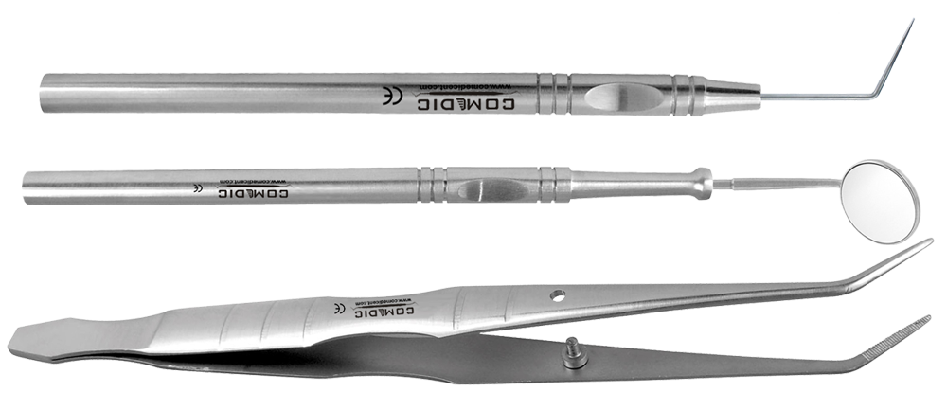
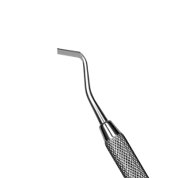
Mouth mirror
Explorer
Pair of tweezers
Dental enamel hatchet
Spoon excavator
Glass slab or paper mixing pad and Spatula

Slide 11
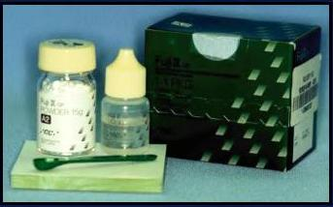
GIC
Powder-silicon dioxide
aluminium trioxide
CaF2,NaF,
Liquid-Polyacrilic acid

Slide 12
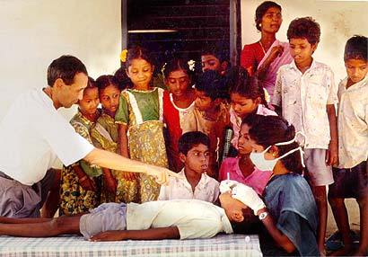
PROCEDURE
A. Positioning of the operator:
provide best view of the inside of patient’s mouth and is comfortable

Slide 13
2. Assistance: Specially required when treating children

Slide 14
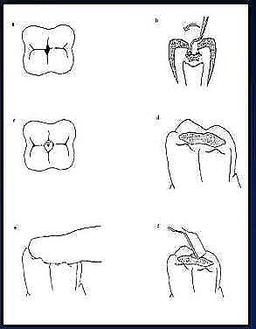
Stepwise ART approach
Isolate
Access
Excavate
Condition
Restore
Press
Remove excess

Slide 15
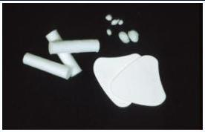
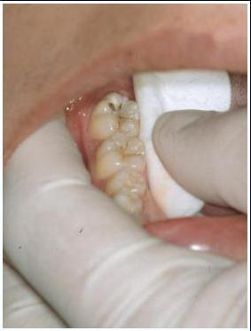
Isolate

Slide 16
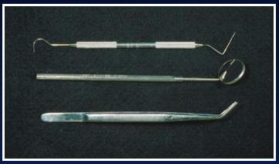
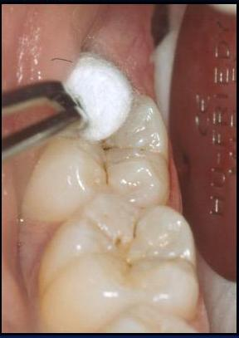
Access

Slide 17
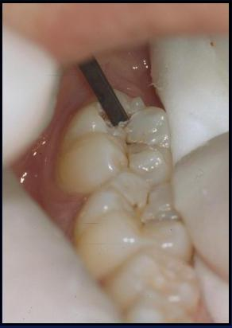
Excavate

Slide 18
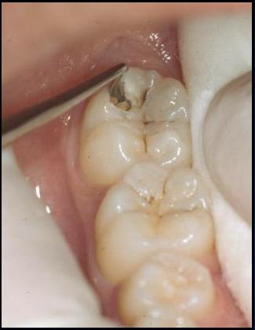

Slide 19
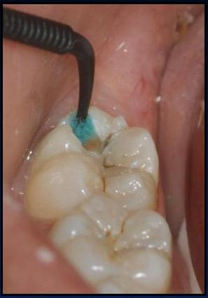
Condition

Slide 20
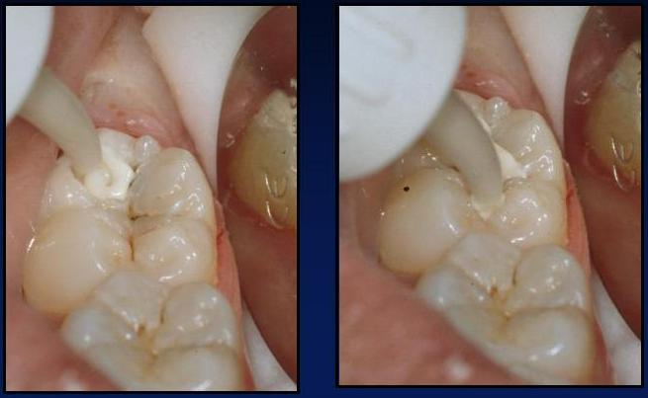
Restore

Slide 21
Check occlusion

Slide 22
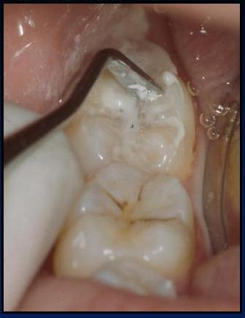
Removal of excess

Slide 23
Conclusion
ART IS MAXIMALLY PREVENTIVE AND MINIMALLY INVASIVE APPROACH TO STOP FURTHER PROGRESSION OF DENTAL CARIES.
ART as an additional means of providing care to the general public.
This technique has the potential to make oral health care more available to a larger part of the worlds population than before.

Slide 24
References
Norman .Harris. Principles of Preventive dentistry.
Peter S. Essentials of preventive and community dentistry. 5th ed
Frencken J.E, Songpaisan Y, Phantumvanit P, Pilot T. An atraumatic restorative treatment (ART) technique: evaluation after one year. International Dental Journal; 1994: 49(5): 460-464.
Frencken J.E., Matoni F, Sithole W.D. ART restoration and glass ionomer sealants in Zimbabwe survival after 3 years. Community Dent Oral Epidemiol 1998; 26: 372-381.

