Slide 1
DETAILS OF DEPARTMENT OF PEDODONTICS

Slide 2
LIST OF EQUIPMENTS
S. No | NAME | Quantity | Availability
1 | Dental Chairs and Units | One chair and unit per post-graduate student and Two chairs with unit for the faculty | One chair and unit per post-graduate student and Two chairs with unit for the faculty
 |  | 1 Unit | 1 Unit
2 | Pedo extraction forceps & elevators sets | 3 | 3
3 | Autoclaves for bulk instrument sterilization vacuum (Front loading) | 1 | 1
4 | RVG with intra oral x-ray unit | 1 | 1
5 | Automatic developer | 1 | 1
6 | Pulp tester | 2 | 2
7 | Apex locator | 1 | 1
8 | Rubber dam kit | 1 | 1
9 | Injectable GP condenser | 1 | 1
10 | Endodontic pressure syringe | 1 | 1
11 | Glass bead steriliser | 2 | 2
12 | Spot welder | 2 | 2
13 | Ultrasonic scalers | 2 | 2
14 | Needle destroyer | 1 | 1
15 | Formalin chamber | 1 | 1

Slide 3
16 | Ultrasonic cleaner capacity 3.5 lts | 1 | 1
17 | X-ray viewer | 2 | 2
18 | Amalgamator | 1 | 1
19 | Plaster dispenser | 2 | 2
20 | Dental lathe | 1 | 1
21 | Heavy Duty Vibrator (Whip mix) | 2 | 2
22 | Typhodont | 1 | 1
23 | Typhodont Permanent Teeth | 3 | 3
24 | Soldering unit | 1 | 1
25 | Band pinching beak pliers | 2 Sets | 2 Sets
26 | Proximal contouring pliers | 2 | 2
27 | Crown crimping pliers | 2 | 2
28 | Double beak pliers anterior and posterior | 2 | 2
29 | Lab micro motor | 2 | 2
30 | Acryliser | 1 | 1
31 | Magnifying loupes | 1 | 1
32 | Conscious sedation unit | 1 | 1
33 | Pulse oxymeter | 1 | 1
34 | Phantom head table with attached Light, Airotor and micro motor | 1 | 1
35 | Computer with internet connection with attached printer and scanner | 1 | 1
36 | LCD projector | 1 | 1
37 | Refrigerator | 1 | 1
38 | Endodontic microscope | 1 | 1

Slide 4
39 | Soft tissue laser | 1 | 1
40 | Model trimmer | 1 | 1
41 | Endomotor | 1 | 1
42 | Adjustable Mouth prop A. Infant mouth gag (MGI) B. Child mouth gag (MGC) C. Adult mouth gag (MGA) | 1 (of each Size) | 1 (of each Size)
43 | Papoose Board (Small, Regular, Large size, Extra large size) | 1 (of each Size) | 1 (of each Size)
44 | Head & Arm Immobilizers (Small, Regular, Large size,) | 1 (of each Size) | 1 (of each Size)
45 | Bracket holding pliers | 3 | 3
46 | Straight hoe pliers | 3 | 3
47 | Curved hoe pliers | 3 | 3
48 | Intraoral camera with screen | 3 | 3
49 | Television | 1 | 1

Slide 5
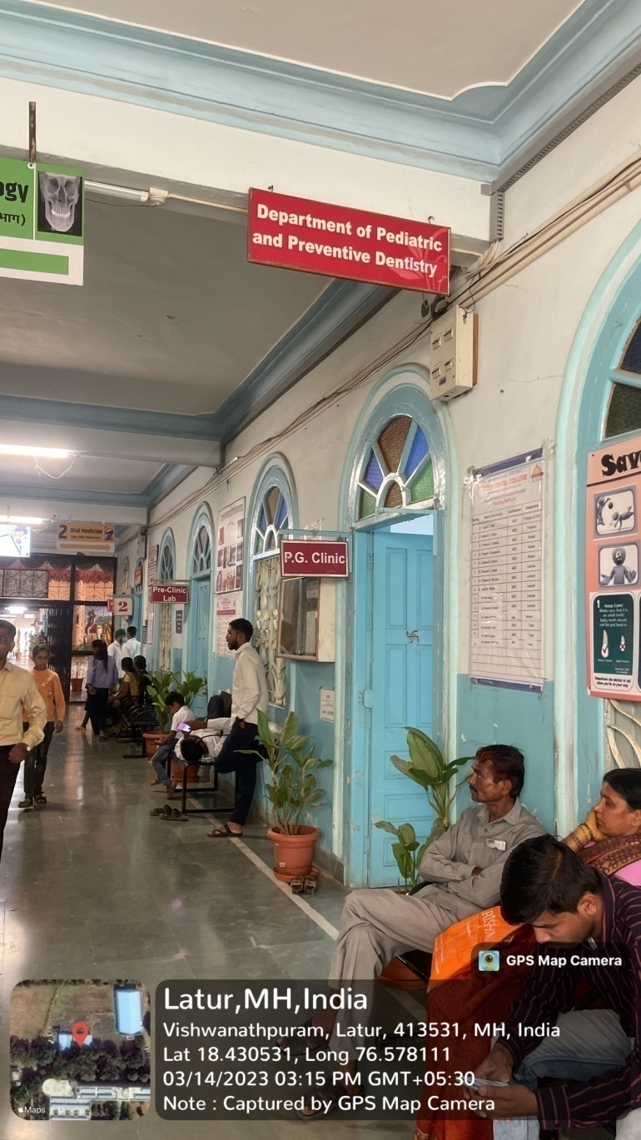
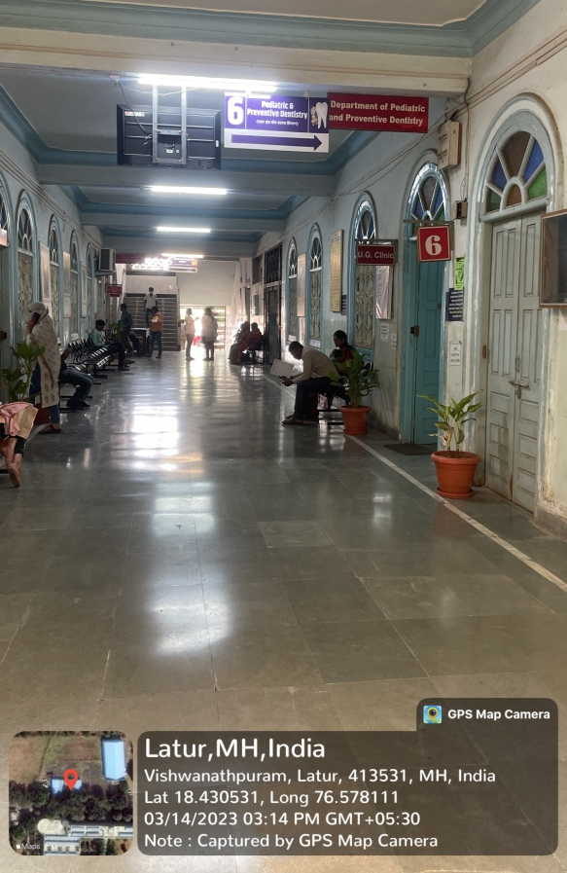
DEPARTMENT OF PAEDODONTICS
DEPARTMENT OF PAEDODONTICS
PATIENT WAITING AREA

Slide 6
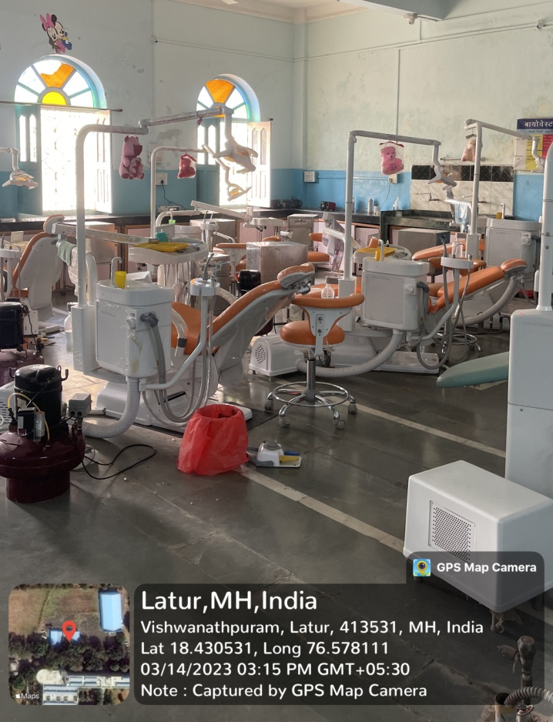
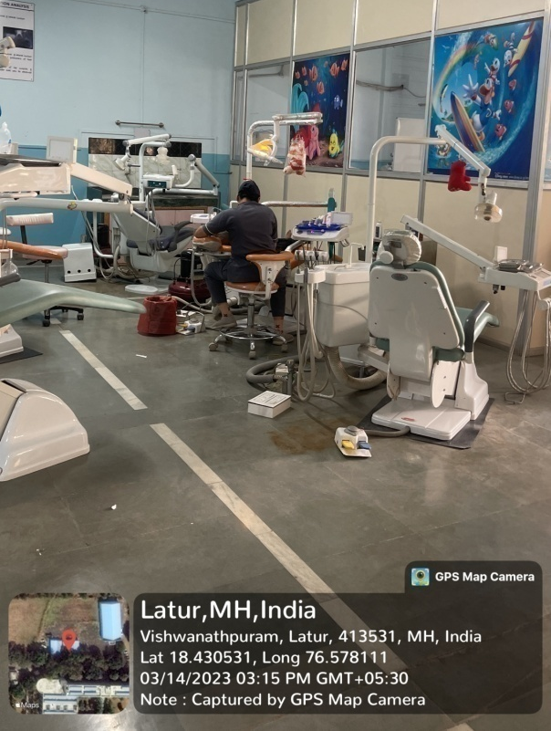
DEPARTMENT OF PAEDODONTICS – POST GRADUATE SECTION

Slide 7
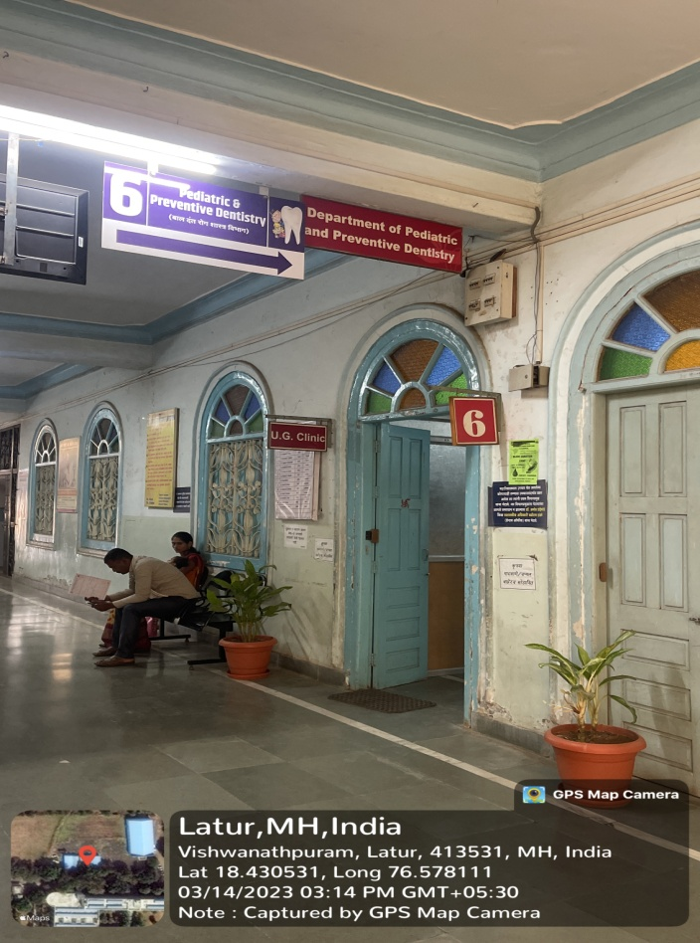
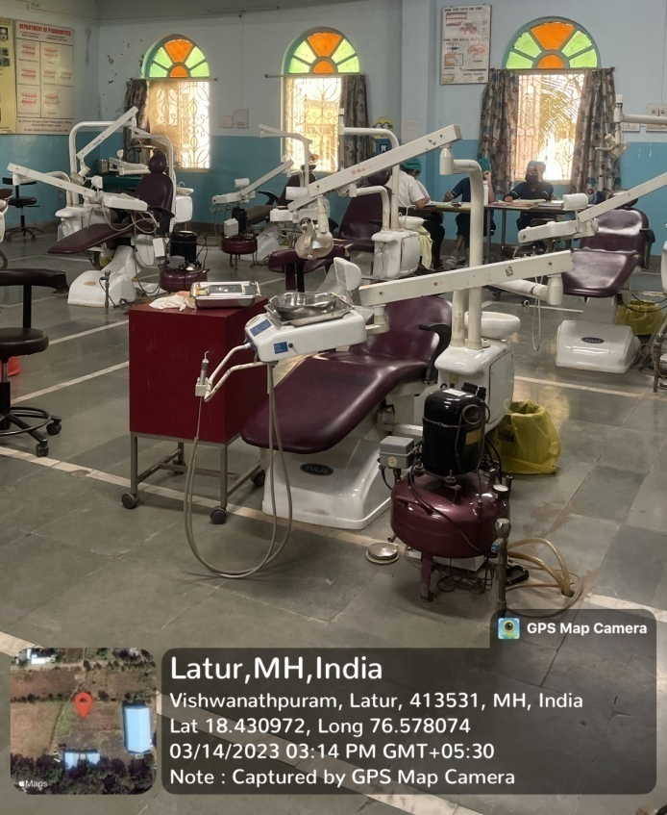
DEPARTMENT OF PAEDODONTICS – UNDER GRADUATE SECTION

Slide 8
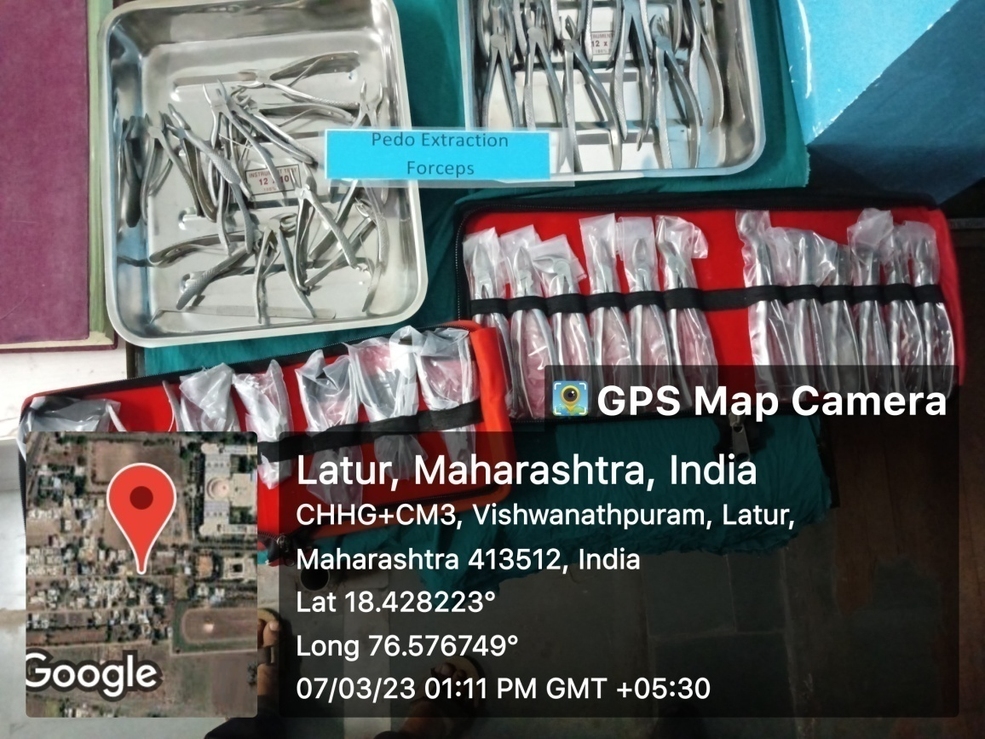
PEDO EXTRACTION FORCEPS & ELEVATORS SETS
AUTOCLAVE

Slide 9
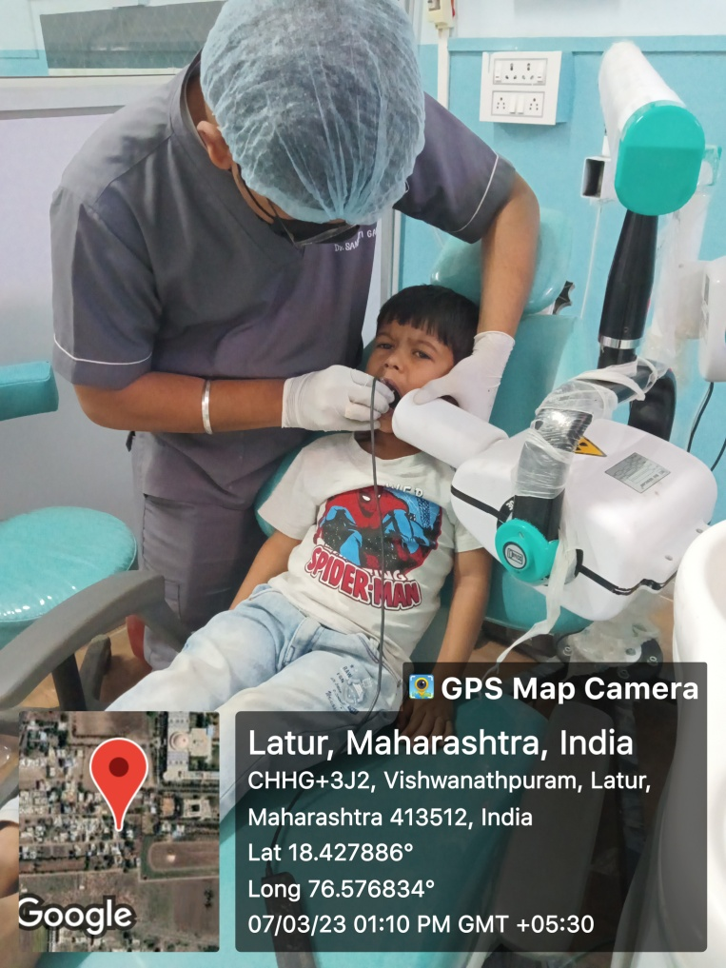
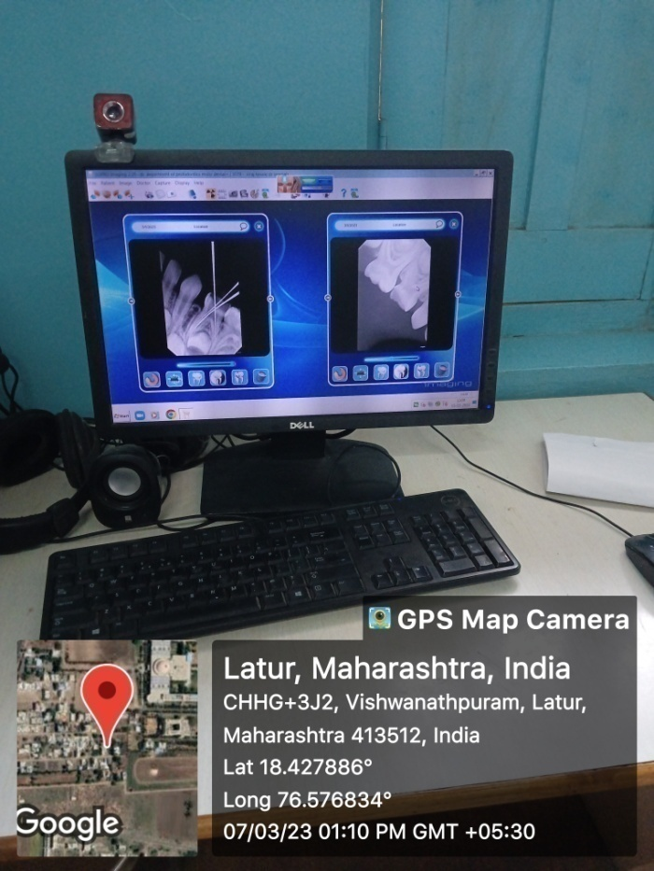
RVG WITH INTRA ORAL X-RAY UNIT

Slide 10
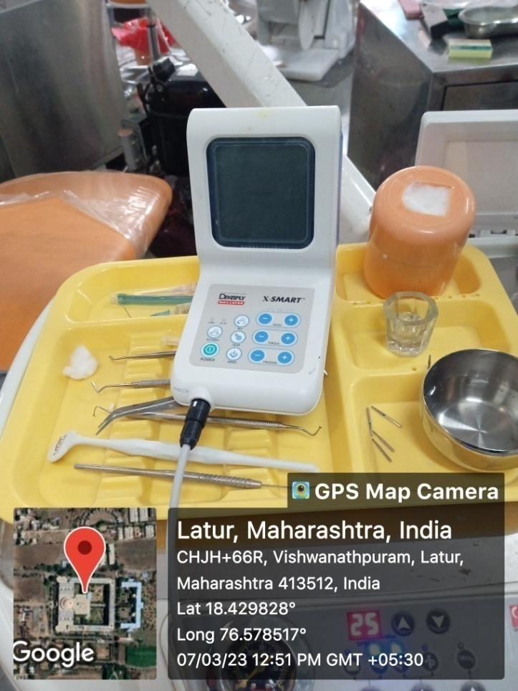
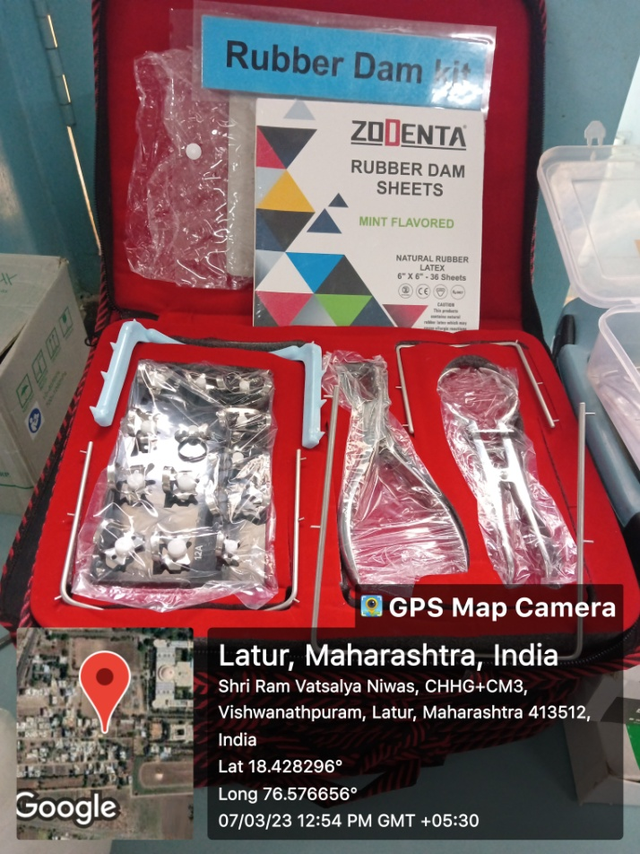
APEX LOCATOR
RUBBER DAM KIT

Slide 11
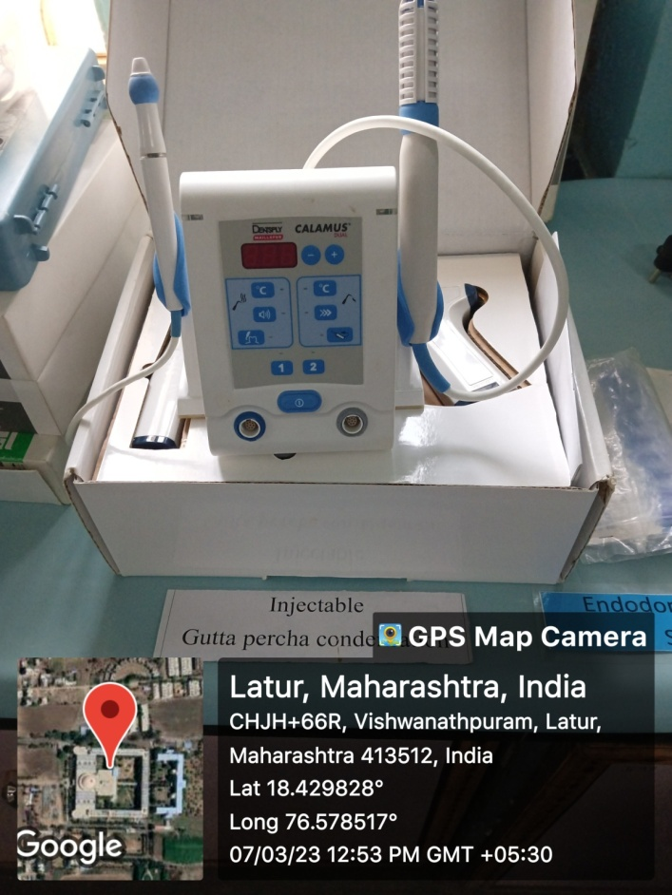
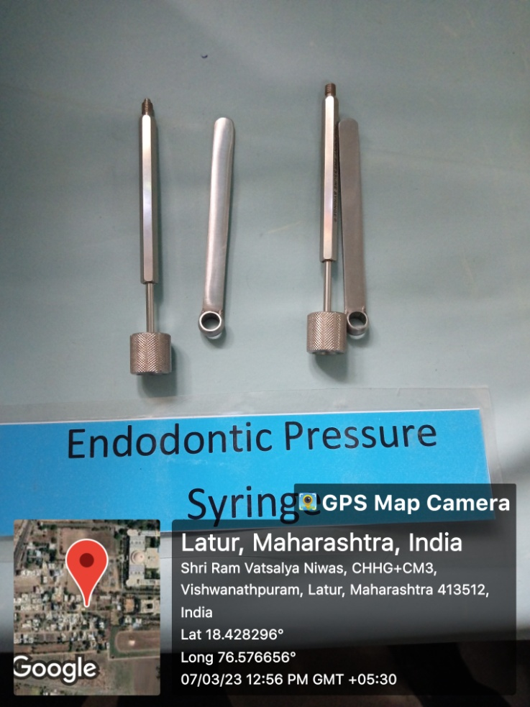
INJECTABLE GUTTA PERCHA CONDENSER
ENDODONTIC PRESSURE SYRINGE

Slide 12
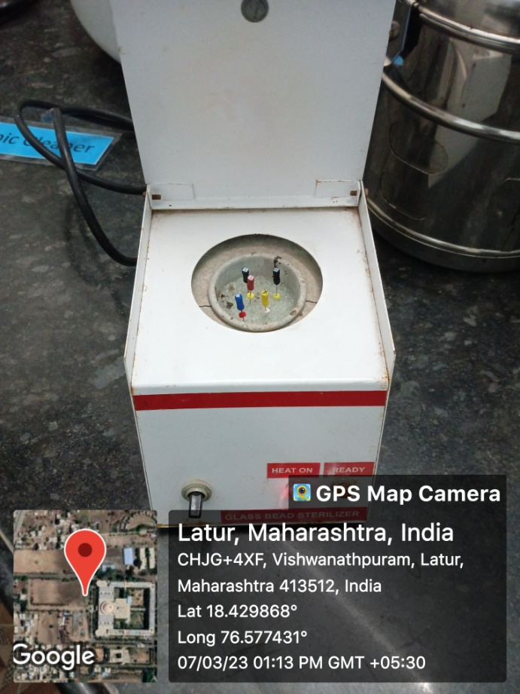
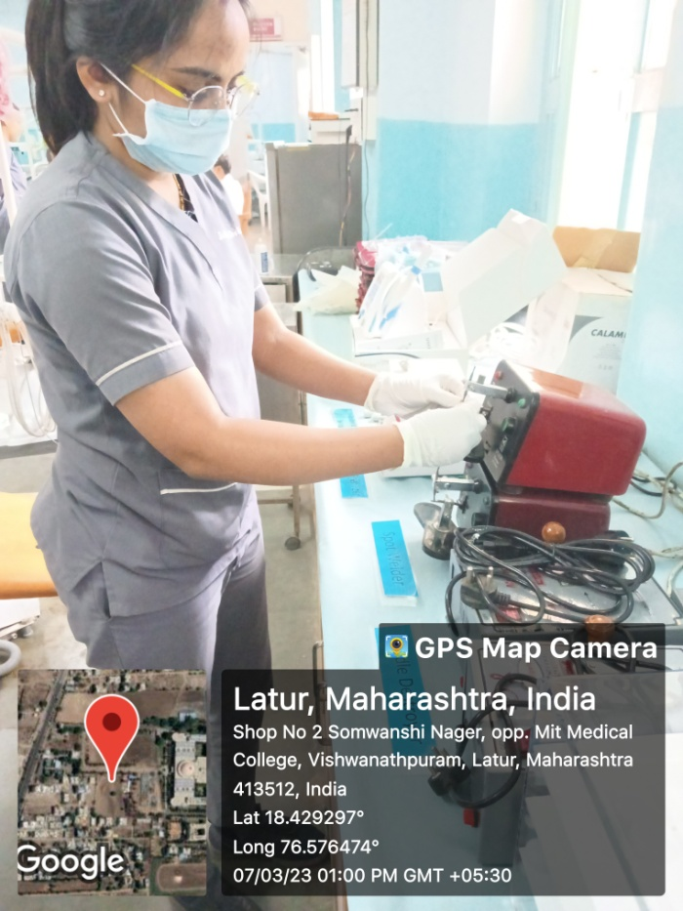
GLASS BEAD STERILISER
SPOT WELDER

Slide 13
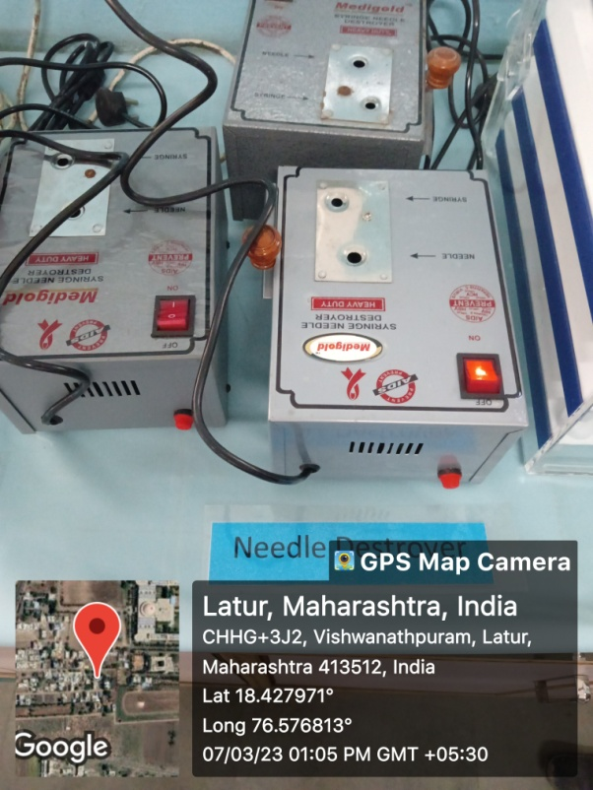
ULTRASONIC SCALERS
NEEDLE DESTROYER

Slide 14
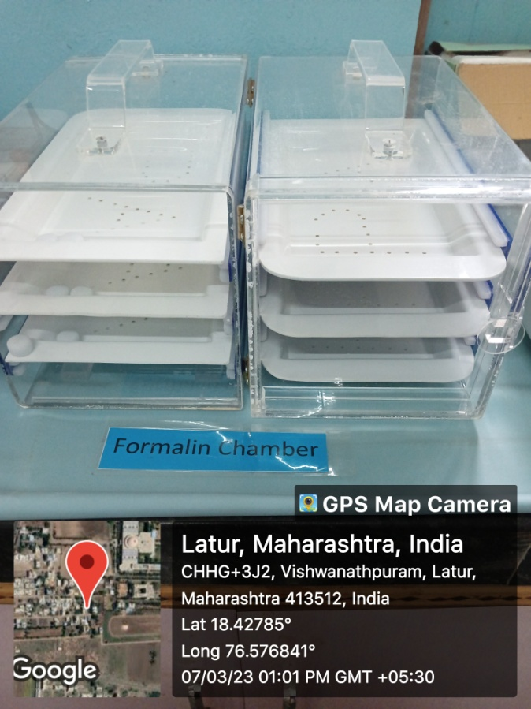
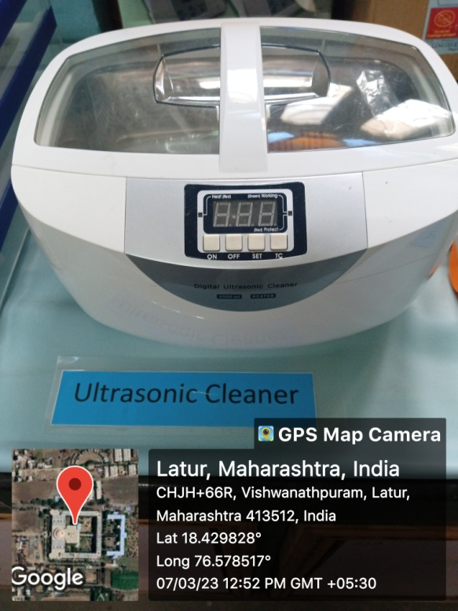
FORMALIN CHAMBER
ULTRASONIC CLEANER CAPACITY 3.5 LTS

Slide 15
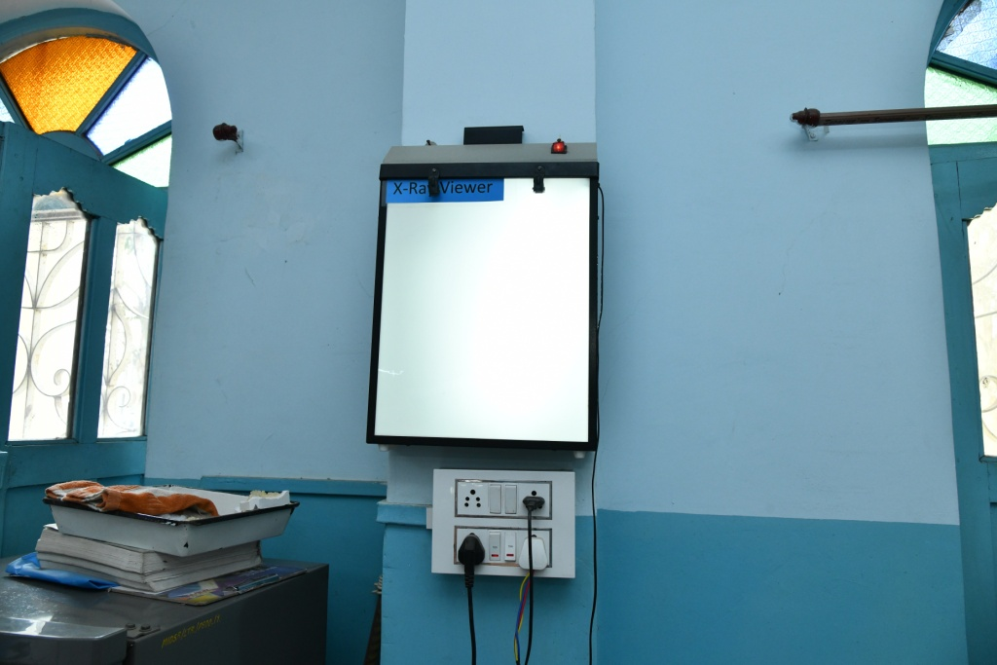
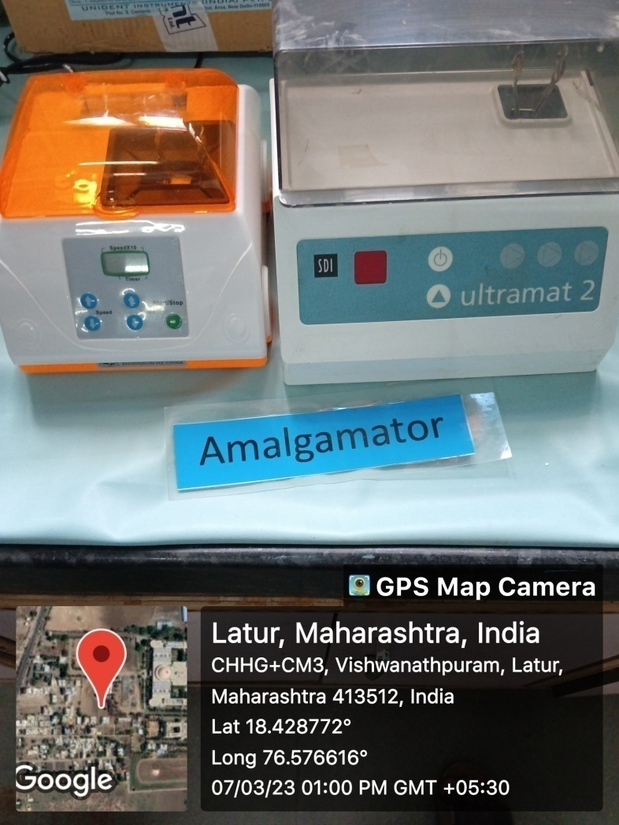
X-RAY VIEWER
AMALGAMATOR

Slide 16
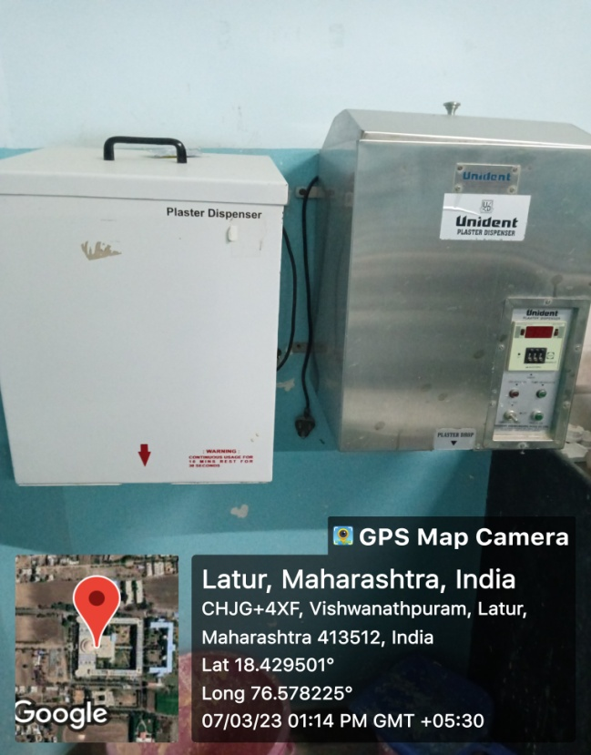
PLASTER DISPENSER
DENTAL LATHE

Slide 17
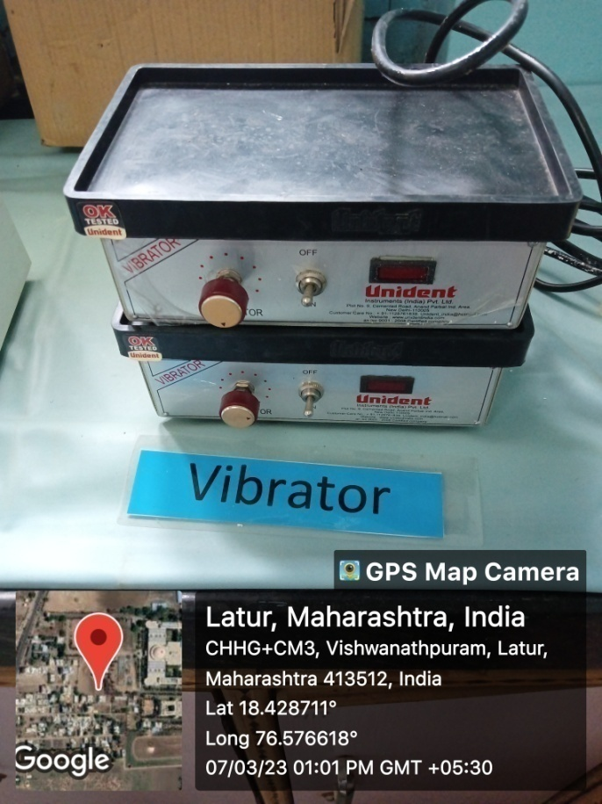
HEAVY DUTY VIBRATOR (WHIP MIX)
TYPHODONT

Slide 18
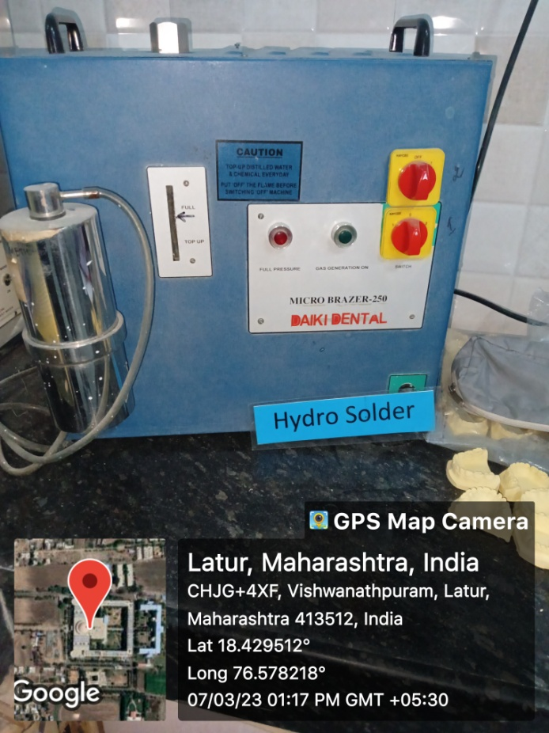
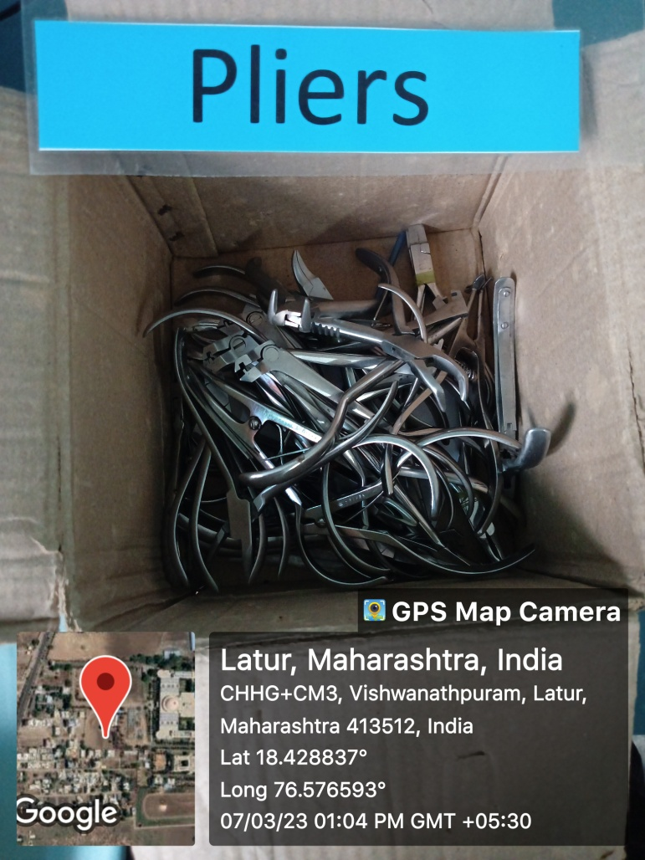
SOLDERING UNIT
PLIER SET

Slide 19
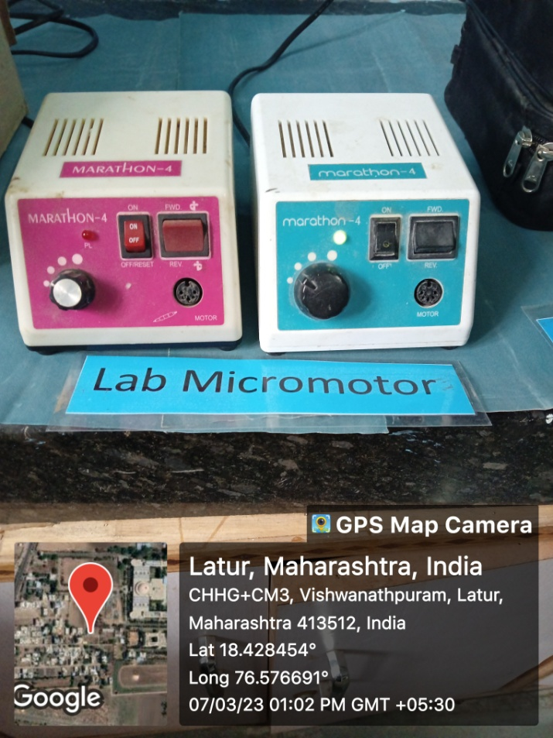
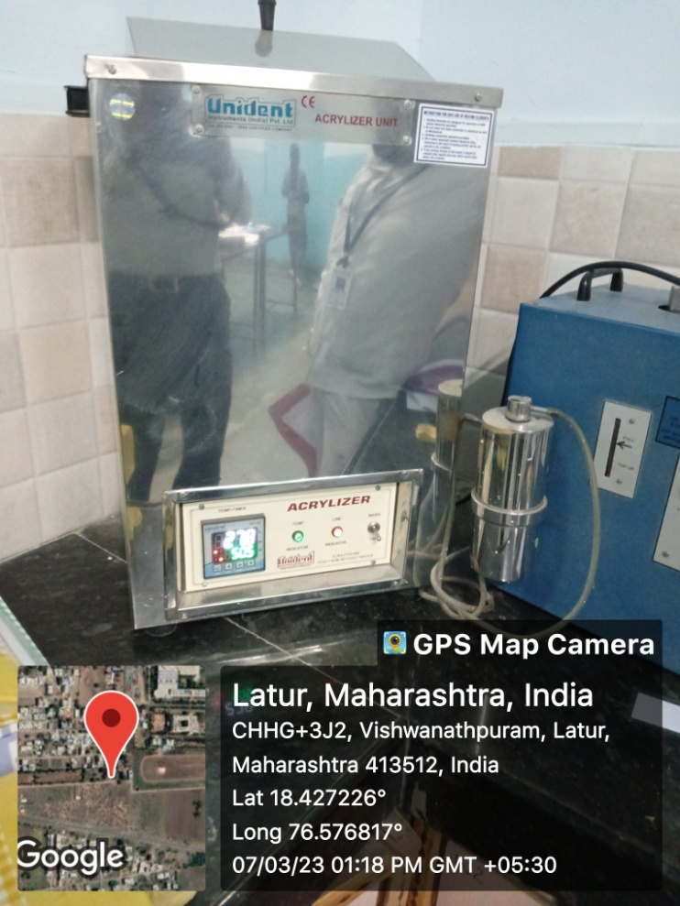
LAB MICRO MOTOR
ACRYLISER

Slide 20
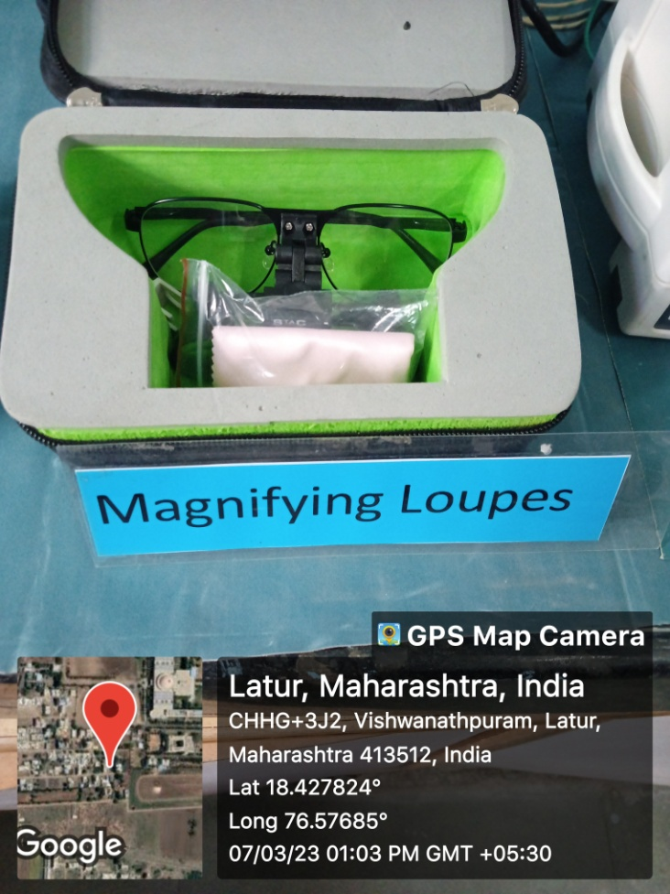
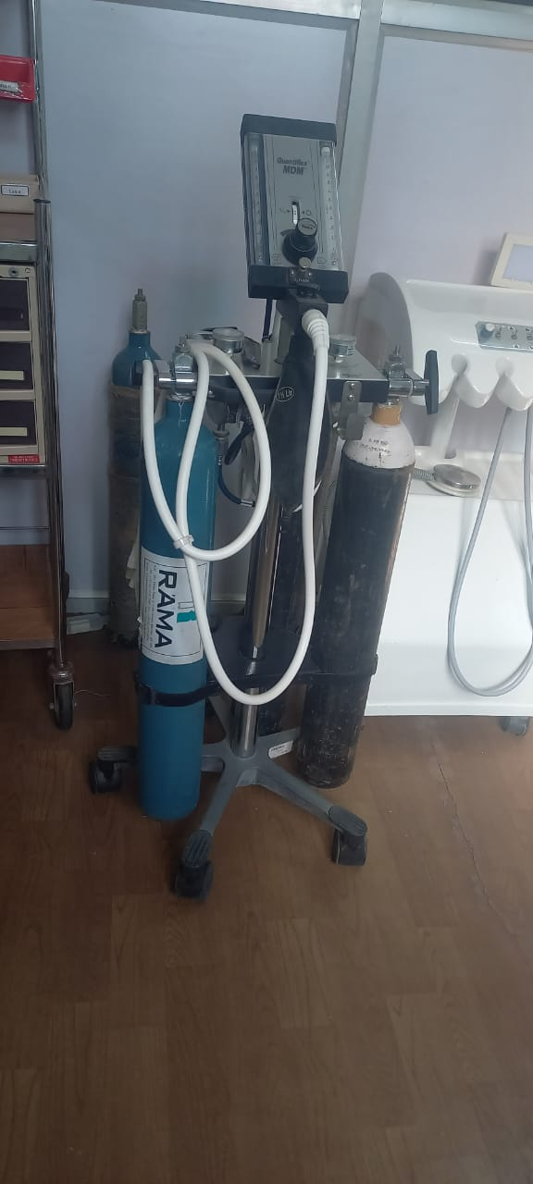
MAGNIFYING LOUPES
CONSCIOUS SEDATION UNIT

Slide 21
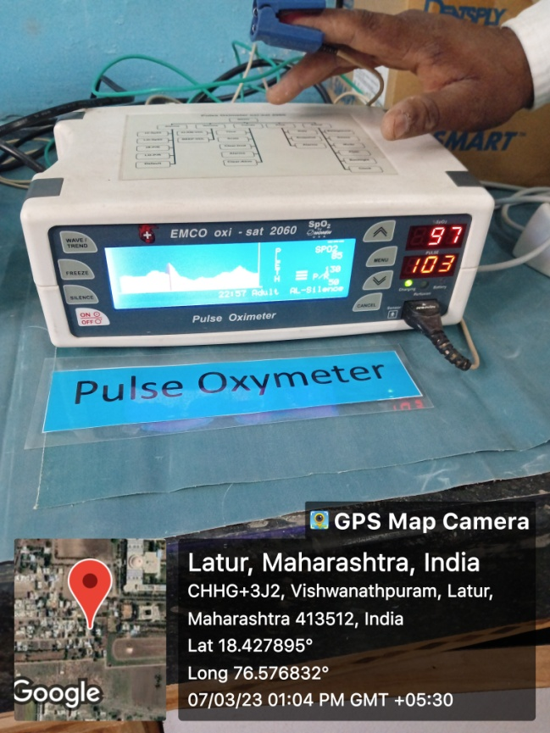
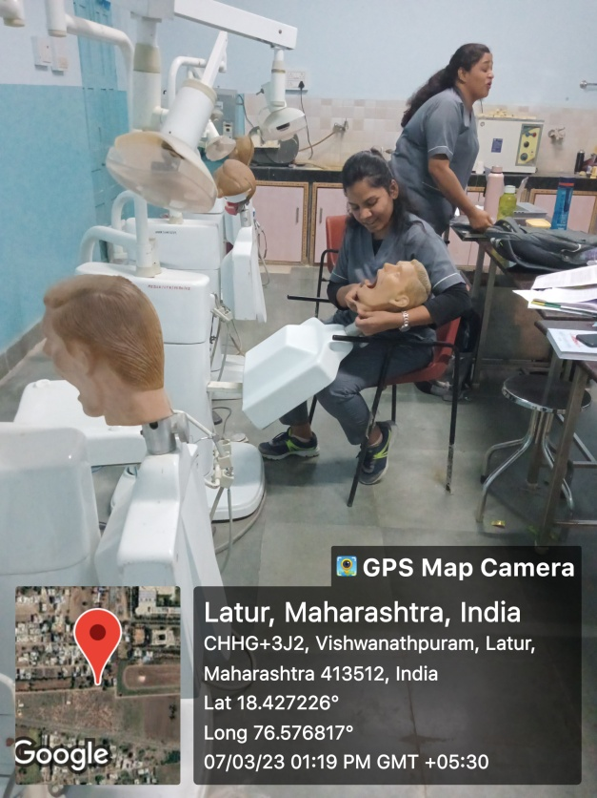
PULSE OXYMETER
PHANTOM HEAD TABLE WITH ATTACHED LIGHT, AIROTOR AND MICRO MOTOR

Slide 22
COMPUTER WITH INTERNET CONNECTION WITH ATTACHED PRINTER AND SCANNER
LCD PROJECTOR

Slide 23
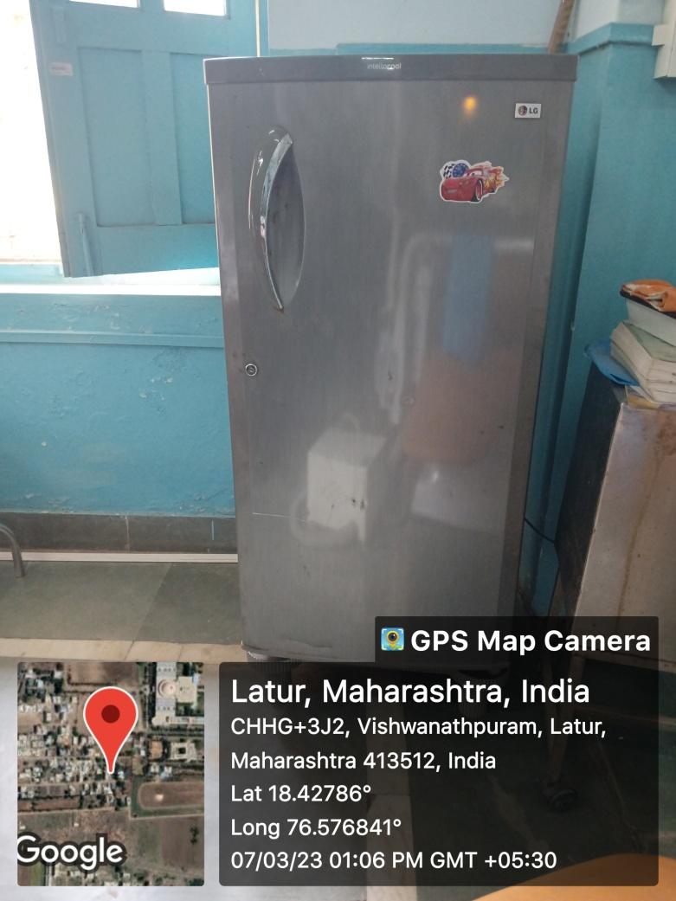
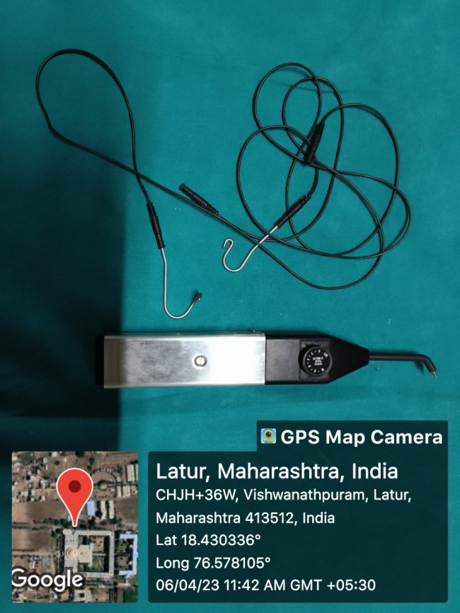
REFRIGERATOR
PULP TESTER

Slide 24
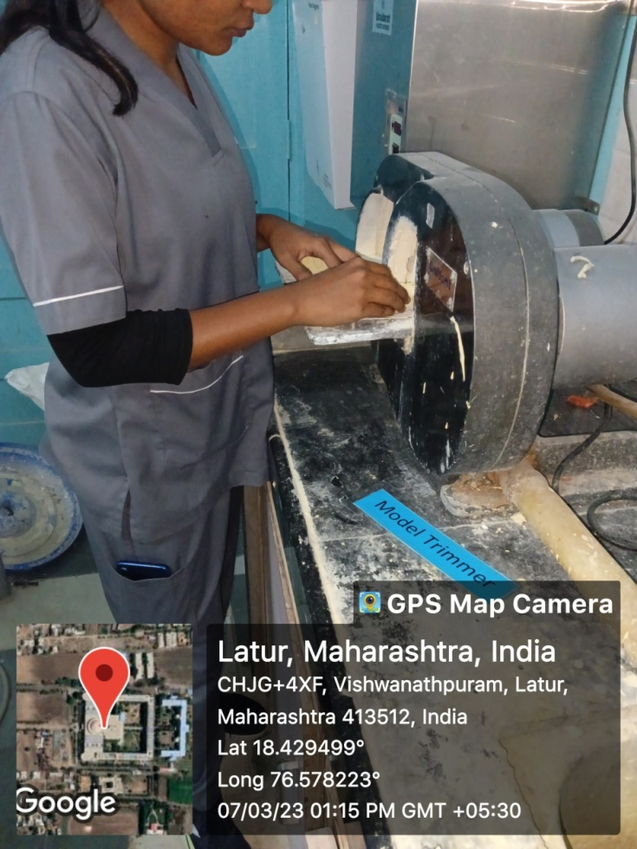
BAND PINCHING BEAK PLIERS
MODEL TRIMMER

Slide 25
Adjustable Mouth prop
A. Infant mouth gag (MGI)
B. Child mouth gag (MGC)
C. Adult mouth gag (MGA)
CROWN CRIMPING PLIERS
PROXIMAL CONTOURING PLIERS

Slide 26
STRAIGHT HOE PLIERS
CURVED HOE PLIERS

Slide 27
INTRAORAL CAMERA
TELEVISION

Slide 28
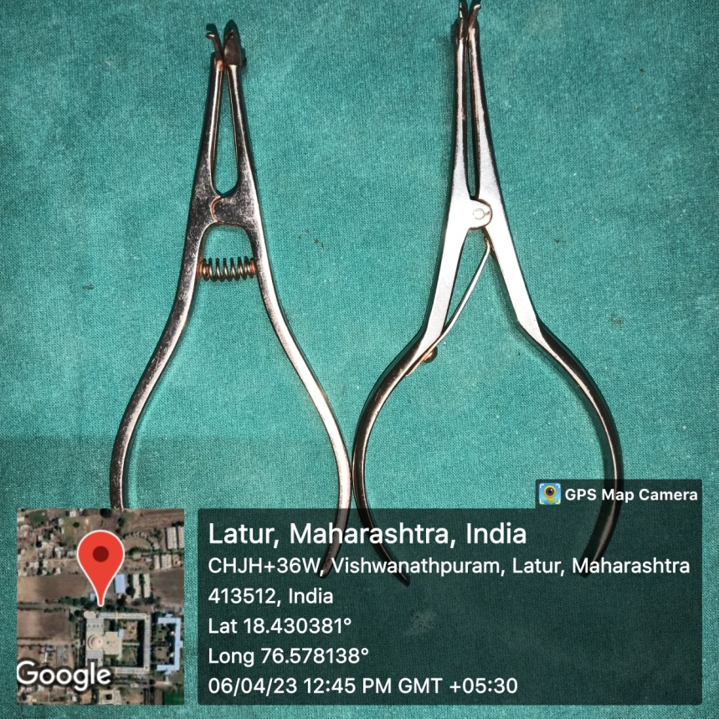
ENDOMOTOR
DOUBLE BEAK PLIERS

Slide 29
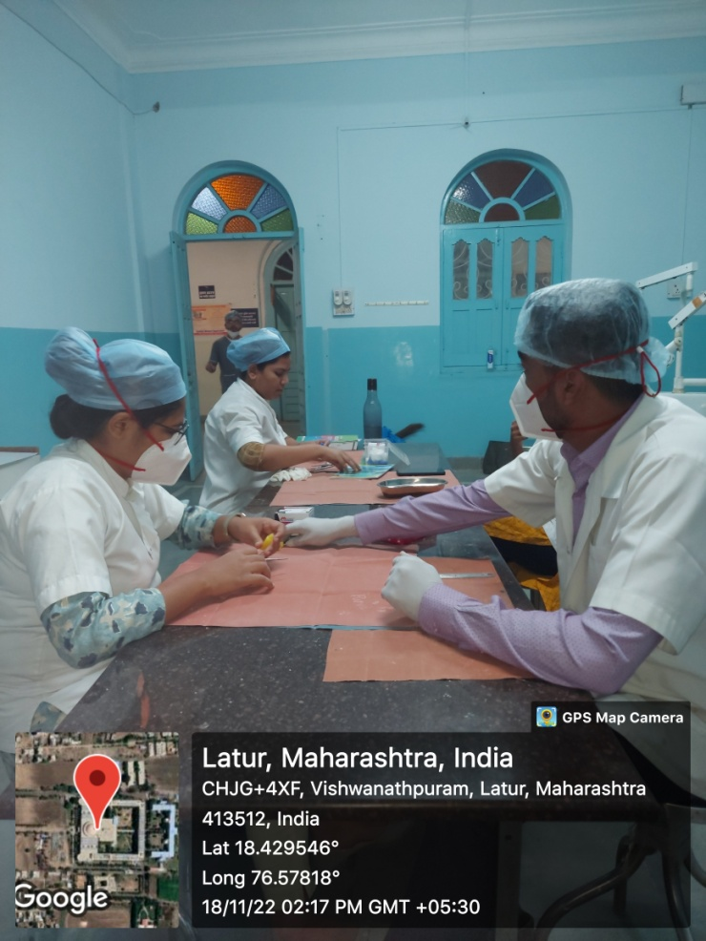
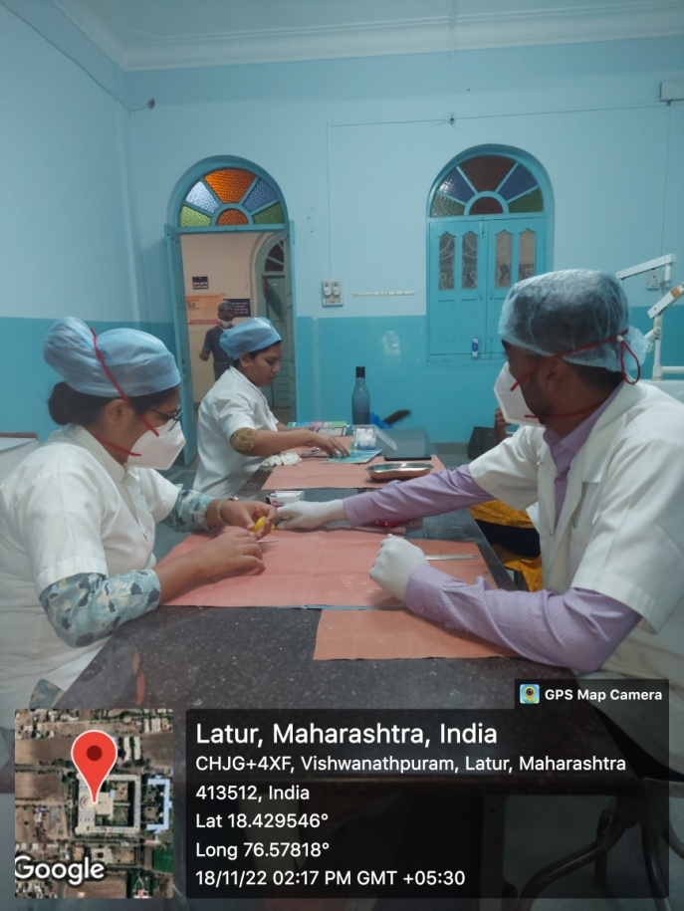
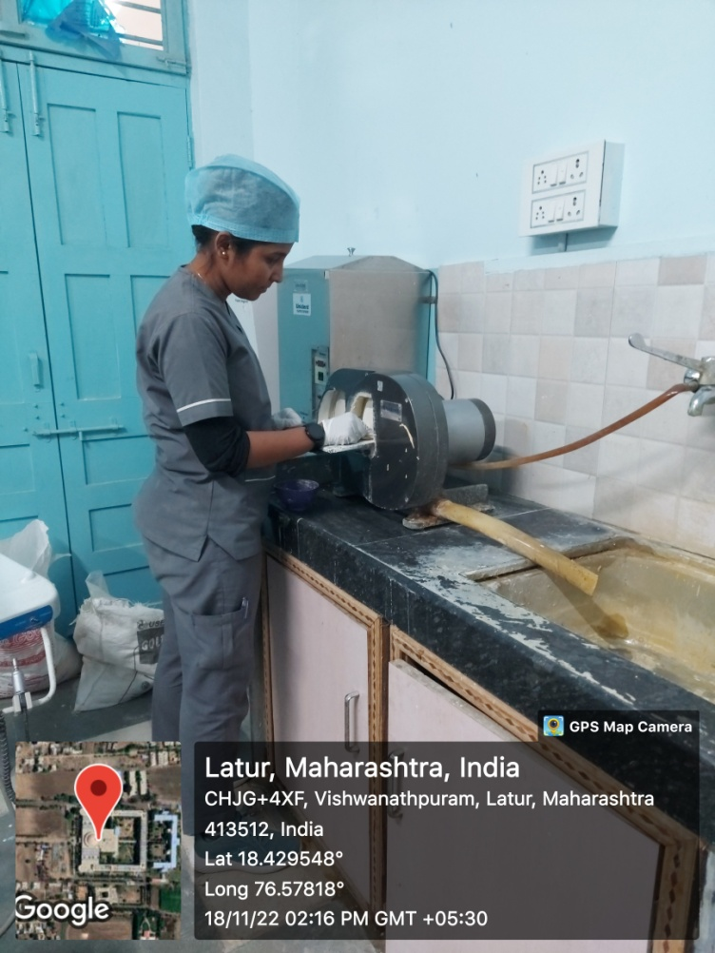
Preclinical PG

Slide 30
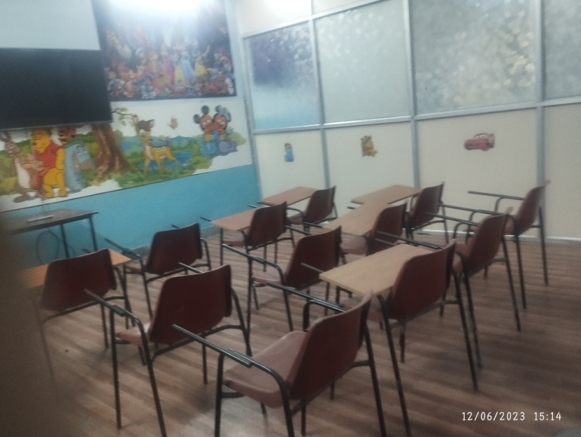
Seminar Room

