Slide 1
Benign Tumors of Oral Cavity

Slide 28
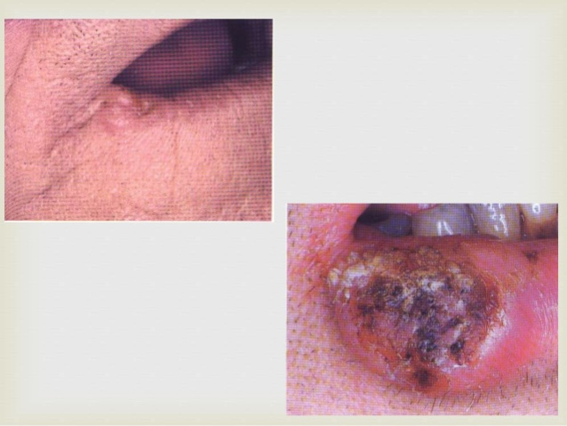

Slide 30
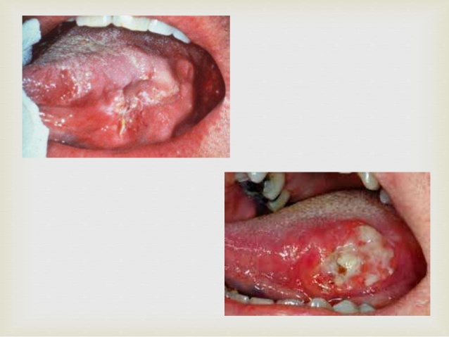

Slide 32
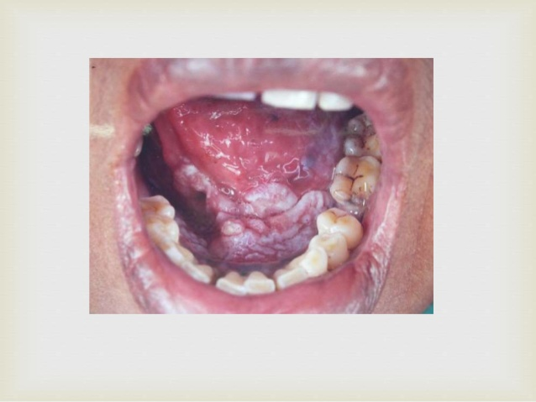

Slide 79
Benign tumors of jaws

Slide 85
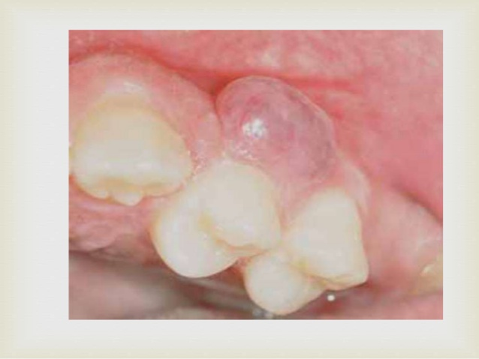

Slide 93
Clinical features
The tumor occurs most commonly in the middle age, and the mean age was 40 years
no sex predilection
A painless, slow growing swelling is the most common presenting sign
two-thirds of the cases were reported in the mandibular posterior region

Slide 94
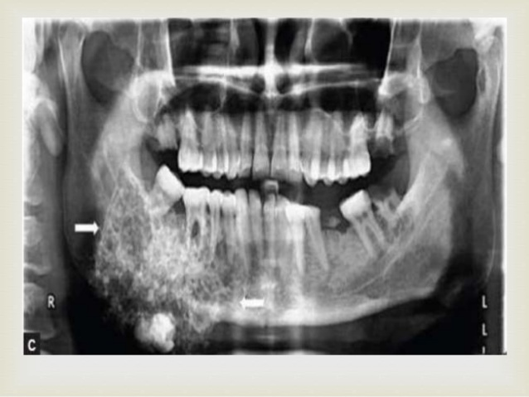

Slide 98
