Slide 1
Pericoronal Radiolucency

Slide 8
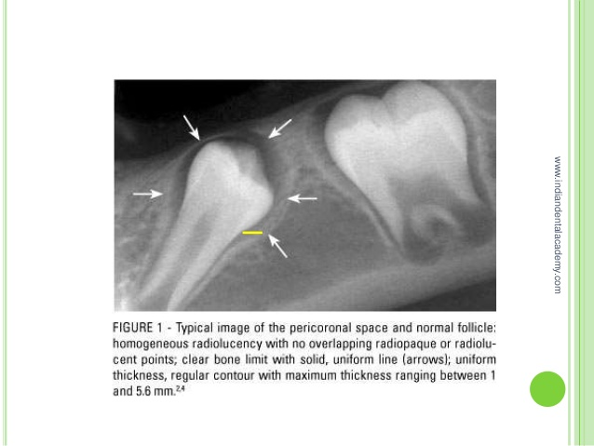

Slide 57
Thank you

