Slide 1
Digital Imaging

Slide 2
Analog versus digital
Digital refers to the numeric format of the image content and its discreteness due to
Spatial distribution of the picture elements/pixels
Different shades of gray of each of the pixels
Digital image consists of a large collection of individual pixels organized in a matrix of rows and columns
At each pixel of an electronic detector, the absorption of x rays generates a small voltage and is analog signal

Slide 4
Analog to digital conversion
Sampling: a small range of voltage values are grouped together a s a single value
Quantized: every sampled signal is assigned a value
The values are stored in the computer and represent the image
The computer organizes the pixels in their locations and displays a shade of gray that corresponds to the number that was assigned during the quantization step.

Slide 5
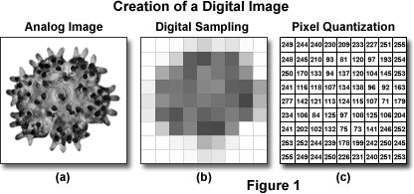

Slide 6
Digital image receptors
Solid-state technology
Photostimulable phosphor technology

Slide 7
Solid-state detectors
Collect the charge generated by x rays in a solid semiconducting material
Matrix and its associated readout and amplifying electronics are enclosed within a plastic housing
Most detectors incorporate an electronic cable to transfer data to the computer.
Advantage: rapid availability of the image after exposure
Disadvantage: miniaturization of electronic components
Cable connection can be replaced with RF transmitter, thereby increasing electronic components and increasing overall bulk of sensor.

Slide 8
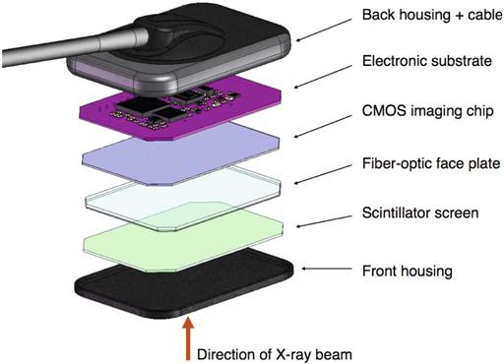

Slide 9
Charge-Coupled device
It uses thin wafer of silicon for image recording
Silicon crystals are formed in picture element matrix
CCD are more sensitive to light than to x rays, a layer of scintillating material is coated directly on CCD surface or coupled to surface by fiberoptics.

Slide 10
Covalent bonds b/w silicon atoms are broken
Exposed to radiation
Electron-hole pairs are produced
Number of electron –hole pairs produced is proportional to amount to amount of exposure an area receives
As charge reaches the end of its row, it is transferred to a read out amplifier and transmitted as a voltage to ADC located within or connected to computer
Image is read by transferring each row of pixel charges from one pixel to the next in “Bucket Brigade”
The electrons are then attracted to the most positive potential in the device, creating charge-packets
Each packet corresponds to one pixels
Charge pattern formed from each pixels in matrix represents latent image

Slide 11
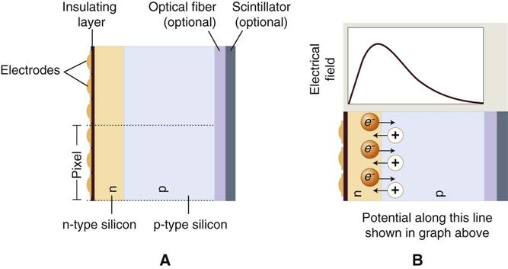

Slide 12
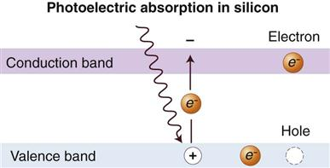

Slide 13
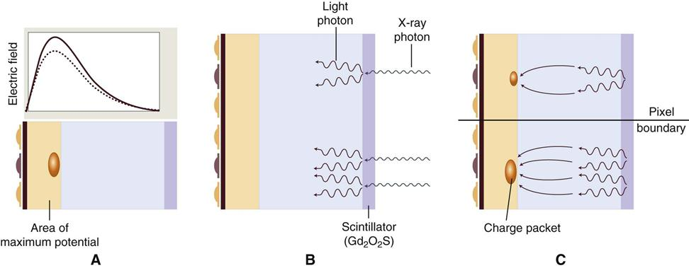

Slide 14
Complementary Metal Oxide Semiconductors
Are silicon based semiconductors
Each pixel is isolated from neighboring pixels and is directly connected to a transistor
Electron hole pairs are generated within the pixel in proportion to the amount of x ray energy that is absorbed
This charge is transferred to the transistor as a small voltage
The voltage in each transistor can be addressed separtely, read by frame grabber and then stored and displayed as a digital gray value

Slide 15
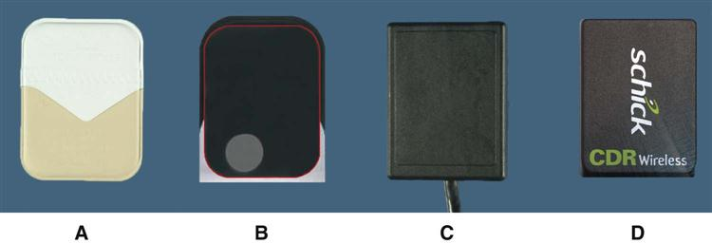

Slide 16
Flat panel detectors
Indirect detectors: are sensitive to visible light and an intensifying screen is used t convert x ray energy into light.
Direct detectors: uses a photoconductor material, permitting more efficient absorption of x rays.
In influence of applied electrical field, the electrons that are freed during x ray exposure of selenium are conducted in a direct line to underlying thin film transistor detector element (TFT).
The electrical energy generated is proportional to x ray exposure and is stored at each pixel in a capacitor

Slide 17
Photostimulable Phosphor
PSP plates absorb and store energy from x rays and then release this energy as light when stimulated by another light of appropriate wavelength.
PSP material used is ‘europium-doped” barium fluorohalide
Barium in combination with iodine, chlorine or bromine forms a crystal lattice.
Addition of europium creates imperfections in the lattice
When exposed to energetic source of radiation, valence electrons in europium can absorb energy and move to conduction band

Slide 18
These electrons migrate to nearby halogen vacancies, F-centres in fluorohalide lattice and may become trapped there in metasatable state
In this state, number of trapped electrons is proportional to x ray exposure and represents a latent image
When stimulated by red light of 600nm, the barium fluoro halide releases trapped electrons to conduction band
When an electron returns to Eu+3, energy is released in the green spectrum b/w 300 and 500nm.

Slide 19
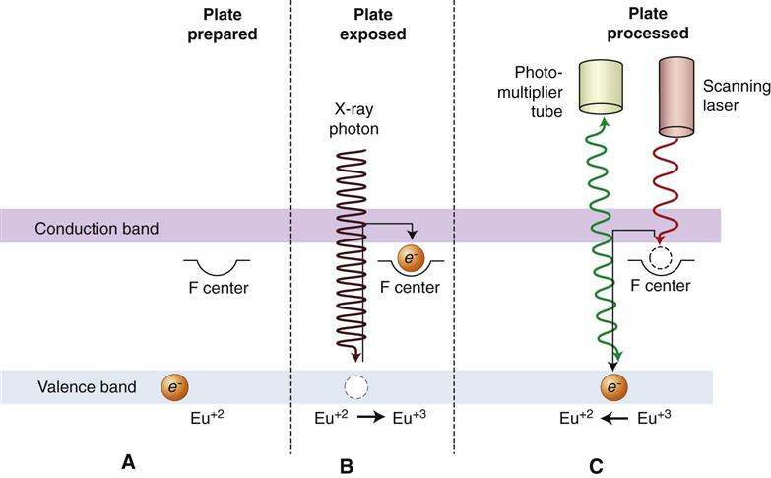

Slide 20
Fiberoptics conduct light from PSP plate to photomultiplier tube
photomultiplier tube converts light into electrical energy
A red filter at photomultiplier tube selectively removes the stimulating laser light, and the remaining green light is detected and converted to a varying voltage
Variations in voltage output corresponds to variations in stimulated light light intensity from the latent image
The voltage signal is quantified by analog-to-digital converter and stored and displayed as a digital image

Slide 21
Barium fluorohalide material is combined with a polymer spread in a thin layer on a base material to create a PSP
Before exposure, PSP plates must be erased to eliminate ghost images from prior exposures and is accomplished by flooding the plate with a bright light.

Slide 22
Digital detector characteristics
Contrast resolution
Spatial resolution
Detector latitude
Detector sensitivity

Slide 23
Contrast resolution
It is the ability to distinguish different densities in r/g image
It is the function of:
Attenuation characteristics of tissues imaged
Capacity of image receptor to distinguish differences in no of x ray photons coming from different areas of subject
Ability of the computer display to portray differences in density
Ability of the observer to recognise those differences

Slide 24
Current digital detectors capture data at 8, 10, 12, or 16 bits
The bit depth is a power of 2, means the detector can capture 256 to 65536 different densities
Computer monitors are capable of displaying a gray scale of only 8 bits and actual no of gray levels is 242
Human visual system is capable is capable of distinguishing 60 gray levels under ideal viewing condition
In dental operatory gray levels fall to less than 30

Slide 25
Spatial resolution
It is the capacity for distinguishing fine detail in an image
Resolution is measured in units of line pairs per mm
Atleast 2 pixels are required to resolve a line pair
Resolution of PSP plates is influenced by thickness of phosphor material
Thick phosphor layers cause more diffusion and a lower resolution
resolution is inversely proportional to diameter of laser beam
Effective beam diameter is increased by vibration in rotating mirror and drum scanner designs
Current PSP plates provide 7lp/mm of resolution

Slide 26
Detector latitude
Ability of an image receptor to capture a range of x ray exposures is termed latitude
The latitude of CCD and CMOS detectors is similar to that of film and can be extended with digital enhancement of contrast and brightness

Slide 27
Detector sensitivity
Sensitivity or spped of a detector is its ability to respond to small amounts of radiation
It is affected by detector efficiency, pixel size, and system noise
PSP allows 50% dose reductions compared with F films
Solid state detectors require less exposure than PSP plates or films

Slide 28
Digital image viewing
Cathode ray tube display
Thin film transitor display
Electronic display considerations
Hard copies - Film printers
Paper printers
Image processing
Image restoration
Image enhancement – brightness and contrast
Sharpening and smoothing
Color
Digital subtraction radiography
Image analysis

Slide 29
Cathode ray tube display
Computer monitor use cathode ray tube designs
A beam of electrons emanating frrom an electron gun rapidly scans a phosphor coated screen
The electron scan is horizontal and builds an image line by line
The image is repeated or refreshed at a rate of 60 times a second or hertz
Color monitor use 3 electron guns for red, blue and green phosphors
Variable intensity of electron beam is responsible for different shades of gray or color hue and intensity

Slide 30
High quality monitors are able to display 256 different gray values
CRT displays involve conversion of digital information into analog voltages, which are supplied to the electron guns
Some image loss occurs in digital to analog conversion
dot pitch – is a measure of the distance b/w groups of subpixels in CRT
Smaller dot pitches provide more pixels per area and sharper looking images
The brightness of the monitor affects perceived contrast in image
Over time, color phosphors in CRT fade, reducing the brightness of monitor and contrast within the image

Slide 31
Thin film transitor display
TFT technology, in laptop and flat panel computer displays
Here the signal is sent is sent to the pixels transistot, which inturn causes the associated liquid crystal display to transmit light with an intensity proportional to transistor voltage
Subpixels composed of red, blue and green phosphors are subjected to varied voltages and in combination create a pixel output of a particular hue and intensity

Slide 32
Electronic display considerations
Quality, capabilities and ease of use of display software varies
Display of images vary depending on how software handles resizing of windows or the size and resolutions of different displays bright background illumination from windows or other sources of ambient light reduces visual contrast sensitivity
light reflecting off a monitor surface may further reduce the visibility of image contrast
Images are best viewed if lighting is subdued and indirect

Slide 33
Hard copies
Printed image should provide adequate image quality to prevent loss of diagnostic information
There should be sufficient assurance that the diagnostic information be retained quality is influenced by printing technology, printer quality, printer settings and type of media
Printing technologies include laser, inkjet and dye sublimation with use of film or paper

Slide 34
Film printers
High quality film printers that use laser or dye sublimation are expensive
Low cost alternatives suffer a reduced diagnostic quality
Current film transparencies produced with ink jet technology appear to be suboptimal for tasks such as caries diagnosis

Slide 35
Paper printers
Paper printed digital radiographs require reflective light from a normally lit room

