Slide 1
Systemic diseases manifested in the jaws

Slide 2
General features
A change in size and shape of bone
A change in no, size and orientation of trabeculae
Altered thickness and density of cortical structures
An increase or decrease in overall density of bone
Changes to teeth and associated structures:
Accelerated or delayed eruption
Hypoplasia
Hypocalcification
Loss of a distinct lamina dura

Slide 3
Hyperparathyroidism
There is an excess of circulating PTH
This increases the bone remodelling in preference of osteoclastic resorption, which mobilizes calcium from the skeleton
PTH also increases renal tubular resorption of calcium and renal production of the active vit D metabolite 1,25(OH)D2
Net result is an increase in serum calcium

Slide 4
Etiology
Primary hyperparathyroidism: benign tumor of one of the 4 parathyroid glands
Hyperplastic parathyroid glands
Combination of hypercalcemia and an elevated serum level of PTH is diagnostic of primary
Secondary hyperparathyroidism: is due to compensatory increase in output of PTH in response to hypocalcemia
Hypocalcemia: due to inadequate dietary intake, poor absorption of vit D, deficient metabolism of vit D in liver or kidney

Slide 5
Clinical features
Women are 2-3 times more commonly affected by primary
30-60 yrs of age
Renal calculi, peptic ulcers, psychiatric problems or bone and joint pain
Gradual loosening of teeth, drifting and loss of teeth
Definite consistent hypercalcemia is pathognomonic of primary
Serum alk phosphatase, reliable indicator of bone turnover, may also be elevated

Slide 6
Radiographic features
General: earliest and most reliable changes are subtle erosions of bone from subperiosteal surfaces of phalanges of hands
Demineralization of skeleton results in unusual r’lucent appearance
Osteitis fibrosa cystica are localized regions of bone loss produced by osteoclastic activity, resulting in loss of all apparent bone structure
Brown tumors occur late, peripheral or central tumors of bone appear r’lucent
Pathologic calcifications in soft tissues have a punctate or nodular appearance and occur in kidneys and joints
In prominent cases, entire calvarium has a granular appearance caused by the loss of diploic trabeculae and thinning of cortical tables

Slide 8
R/G features of the jaws
Demineralization and thinning of cortical boundaries often occur in jaws such as inferior border, mandibular canal and cortical outlines of max sinuses
Density of jaws is decreased, resulting in r’lucent appearance
Teeth stand out in contrast to r’lucent jaws
Trabeculae are numerous, small and randomly oriented giving a ground glass appearance
Brown tumors are seen in facial bones and jaws
Tumors have variably defined margins and may produce cortical expansion

Slide 10
R/G features of the teeth and associated structures
IOPA reveals loss of lamina dura, loss may be around 1 teeth or all teeth, loss may be complete or partial
Loss of lamina dura may give the root a tapered appearance
Management: surgical removal of adenoma
Brown tumors heal with bone that is more sclerotic than normal
All other r/g features reverts to normal

Slide 11
Hypoparathyroidism and pseudohypoparathyroidism
Hypoparathyroidism, in which insufficient secretion of PTH occurs
Damage or removal of parathyroid glands
In pseudohypoparathyroidism, there is a defect in the response of tissue target cells to normal levels of PTH

Slide 12
Clinical features
Both condition produce hypocalcemia
Sharp flexion (tetany) of wrist and ankle joints (carpopedal spasm)
Sensory abnormalities consisting of paresthesia of hands, feet or area around the mouth
Neurological changes include anxiety and depression, epilepsy, parkinsonism and chorea
Chronic forms may produce a reduction in intellectual capacity
Pseudohypoparathyroidism, early closure of certain bony epiphyses and thus manifest short strature or extremity disproportions

Slide 13
Pseudohypoparathyroidism

Slide 14
Radiographic features
Primary change is calcification of basal ganglia
On skull r/g, this calcification appears flocculent and paired within the cerebral hemispheres on PA view
r/g of jaws may reveal dental enamel hypoplasia, external root resorption, delayed eruption or root dilaceration
Treatment: orally administered supplemental calcium and vit D

Slide 15
Hypoparathyroidism

Slide 16
Hyperpituitarism
Syn: acromegaly and giantism
Results from hyperfunction of anterior lobe of pituitary gland, increasing the production of GH
An excess of GH causes overgrowth of all tissues in body
Etiology: benign, functioning tumor of acidophilic cells in anterior lobe of pituitary gland

Slide 17
Clinical features
In children involves gen overgrowth of most hard and soft tissues – giantism
Active growth occurs in those bones in which the epiphyses have not united with the bone shafts
Gen skeletal growth is excessive and may be prolonged in adolescence
Individuals may attain a ht of 7-8 ft or more with normal proportions
Eyes and other parts of CNS do not enlarge

Slide 18
Adults, called acromegaly, has an insidious clinical course
GH excess can stimulate the mandible and phalanges of hands
Mandibular condylar growth may be very prominent
Supraorbital ridges and underlying frontal sinus may be enlarged
Excess GH in adults may also produce hypertrophy of some soft tissues
Lips, tongue, nose and soft tissues of hands and feet typically overgrow in adults to a striking degree

Slide 19
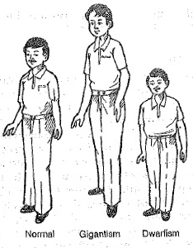

Slide 20
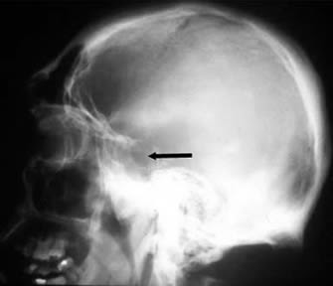
General R/G features
Pituitary tumor often produces enlargement/ ballooning of sella turcica
Skull r/g: enlargement of PNS, splly the frontal sinus
These are more prominent in acromegaly
Diffuse thickening of outer table of the skull

Slide 21
R/G features of the jaws
Causes enlargement of the jaws, mostly mandible
An increase in the length of dental arches results in spacing of teeth
Acromegaly: angle b/w ramus and body may increase
Macroglossia
Anterior flaring of teeth and anterior open bite
In acromegaly, most profound growth occurs in condyle and ramus, resulting in class III skeletal relationship
Thickness and height of alveolar processes may also increase

Slide 23
R/G changes associated with the teeth
Tooth crowns are usually normal in size
Roots of posterior teeth often enlarge as a result of hypercementosis
Hypercementosis may be the result of functional and strucutral demands on teeth
Supraeruption of posterior teeth may occur in an attempt to compensate for the growth of the mandible

Slide 24
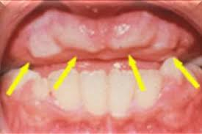
Hypopituitarism
Results from a reduced secretion of pituitary hormones
Individuals show dwarfism and well proportioned bodies
Hypoplatic maxilla and mandible

Slide 25
Radiographic features
Eruption of primary dentition occurs at normal time
Exfoliation is delayed by several yrs
Crowns of permanent teeth form normally and eruption is delayed by several yrs
3rd molar buds may be completely absent
Jaws are small, splly the mandible resulting in crowding and malocclusion
Treatment: removal of cause or replacement of pituitary hormones

Slide 26
Hyperthyroidism
Syn: thyrotoxicosis and Graves disease
Is a syndrome that involves excessive production of thyroxin in thyroid gland
Diffuse toxic goiter/ Graves disease, toxic nodular goiter or toxic adenoma, benign tumor of thyroid gland
Gen increase in metabolic rate of all body tissues
Tachycardia, increased blood pressure, sensitivity to heat and irritability

Slide 28
Radiographic features
Advanced rate of dental development and early eruption
Premature loss of primary teeth
Adults may show a gen decrease in bone density
Or loss of some areas of edentulous alveolar bone

Slide 29
Hypothyroidism
Syn: myxedema and cretinism
Usually results from insufficient secretion of thyroxin by thyroid gland, despite the presence of TSH
c/f: in children, may result in retarded mental and physical development
Base of the skull shows delayed ossification and PNS partially pneumatize
Dental development is delayed and primary teeth are slow to exfoliate

Slide 30
In adults results in myxedematous swelling
Adult symptoms range from lethargy, poor memory, inability to concentrate,constipation and cold intolerance, expressionless face, periorbital edema, large tongue, sparse hair and skin that feels doughy to touch

Slide 32
Radiographic features
Delayed closing of the epiphyses and skull sutures with the production of numerous wormian bones
Delayed eruption, short roots and thinning of the lamina dura
Maxilla and mandible are relatively small
Adult hypothyroidism, periodontal disease, loss of teeth, separtion of teeth as a result of tongue enlargement and external root resorption

Slide 34
Diabetes mellitus
Is a metabolic disorder
Type I is insulin dependent DM results from an absence or insufficiency of insulin
Type 2, noninsulin dependent DM, results from insulin resistance
Lab signs are hyperglycemia and glycosuria
Clinical features: polydipsia, polyuria and in severe cases acetone present in urine and on breath
If not treated, lowers the resistance opf body to infection
Predisposes to, aggravates and accelerates periodontal disease
Xerostomia, about 1/3rd the normal
Caries due to high carbohydrate diet

Slide 36
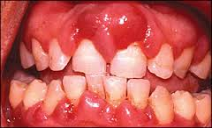
Radiographic features
Periodontal disease is indistinguishable from pts without diabetes

Slide 37
Cushing’s syndrome
Arises from an excess of secretion of glucocorticoids by adrenal glands
This may result from any of the following:
An adrenal adenoma
An adrenal carcinoma
Adrenal hyperplasia, usually bilateral
Basophilic adenoma of anterior lobe of pituitary gland – Cushing’s disease, producing excess ACTH
Medical therapy with exogenous corticosteroids

Slide 38
Clinical features
Pts often show obesity, sparing the extremities
Kyphosis of thoracic spine, buffalo hump
Weakness, hypertension, striae or concurrent diabetes
Affects females, 3 to 5 times as frequently as males
Onset occurs at any age, usually in 3rd or 4th decade

Slide 40
Radiographic features
Primary r/g feature is generalized osteoporosis, having granular bone pattern
This demineralization may result in pathologic fractures
Skull may show diffuse thinning accompanied by mottled appearance
Teeth may erupt prematurely and partial loss of lamina dura may occur

Slide 41
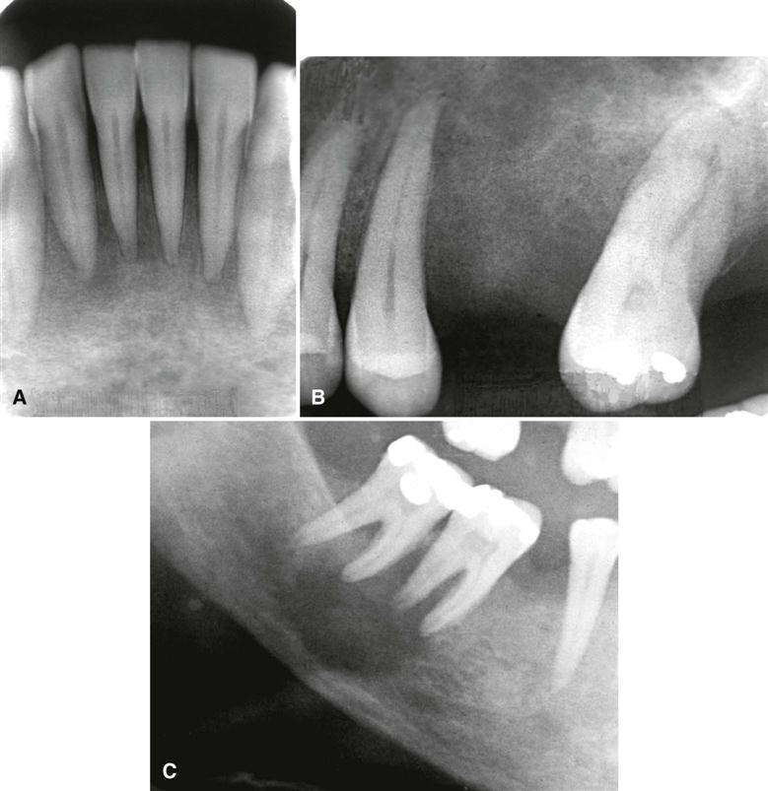

Slide 42
Metabolic bone diseases
Osteoporosis
Rickets and osteomalacia
Hypophosphatasia
Renal osteodystrophy
Hypophosphatemia
Osteopetrosis

Slide 43
Osteoporosis
Is a gen decrease in bone mass an imbalance occurs in bone resorption and formation
Decrease in bone formation results in lower trabecular bone volume and thinning of cortical bone and trabeculae
It is a aging process bone mass normally increase from infancy to 35 to 40 yrs of age
After, a gradual and progressive decline occuring at the rate of 8% per decade in female and 3% per decade in men
Secondary osteoporosis results from nutritional deficiencies, hormonal imbalance, inactivity or corticosteroid or heparin therapy

Slide 44
Clinical features
Most important manifestation is fracture
Most common locations are distal radius, proximal femur, ribs and vertebrae
Pts may suffer from bone pain
Postmenopausal women are at risk

Slide 45
Radiographic features
Results in an overall reduction in the bone density
Reduced density and thinning of cortical boundaries
On occasion, lamina dura may appear thinner than normal
Reduction in the number of trabeculae may be less evident in alveolar process
On occasion lamina dura may appear thinner than normal
Treatment: administration of estrogens and calcium supplements after menopause helps prevent further cortical an trabecular bone loss
Exercise programs are also effective

Slide 46
Rickets and osteomalacia
Results from inadequate serum and extracellular levels of calcium and phosphate
Both result from a defect in normal activity of metabolites of vit D, esplly 1,25(OH)2D, required for resportion of calcium in intestine
Failure of normal mineralization is seen as wide uncalcified osteoid seams
Rickets: when the disease affects the growing skeleton in infants and children
Osteomalacia: when the disease affects mature skeleton in adults

Slide 47
Failure of normal activity of vit D
Lack of vit D in diet
Lack of absorption of vit D resulting from various GI malabsorption problems
Lack of metabolism of active metabolite 1,25(OH)2D that is required for intestinal absorption of calcium

Slide 48
Interference may occur anywhere along the metabolic pathway for 1,25(OH)2D:
Lack of exposure to UV light required for conversion of provitamin D3
Lack of conversion of vitamin D3 to 25(OH)D in liver coz of liver disease
Lack of metabolism of 25(OH)D2 to 1, 25(OH)2D by kidney coz of kidney diseases
A defect in the intestinal target cell response to 1,25(OH)2D or inadequate calcium supply

Slide 49
CLINICAL FEATURES
Rickets: in first 6 months of life, tetany or convulsions are most common due to hypocalcemia
Later, skeletal defects of disease may be more clinically prominent
Craniotabes, a softening of posterior of parietal bones, may be initial sign
Wrists and ankle typically swell
Short strature and deformity of extremities
Development of dentition is delayed, and the eruption rate of teeth is retarded

Slide 50
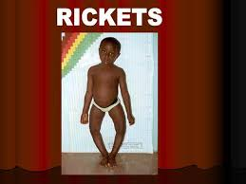
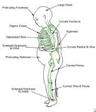

Slide 51
Clinical features
Osteomalacia: most pts have some degree of bone pain
Majority of pts have muscle weakness of varying severity
Peculiar waddling or penguin gait
Tetany
Green stick bone fractures

Slide 52
General Radiographic features
Earliest and most prominent manifestation is widening and fraying of epiphyses of long bones
Soft weight bones such as femur and tibia undergo a characteristic bowing
Greenstick fractures occur In many pts
Osteomalacia: thin cortex
Pseudofractures, which are poorly calcified, ribbon like zones extending into bone at approx right angles to bone margin
Pseudofractures occur commonly in ribs, pelvis and weight bearing bones and rarely in mandible

Slide 53
Radiographic features of jaws
Jaw cortical structures, such as inferior border or walls of mandibular canal may thin
In cancellous bone, trabeculae become reduced in density, no and thickness
In severe cases, jaws appear so radiolucent that the teeth appear to be bereft of bony support
Osteomalacia: no radiographic manifestation seen in jaws
Overall r’lucent appearance and sparse trabeculae

Slide 54
Radiographic changes associated with teeth
Rickets in infancy or early childhood may result in hypoplasia of developing dental enamel
If disease occurs before 3 yrs, enamel hypoplasia is fairly common
Retarded tooth eruption in early rickets
Lamina dura and cortical boundary of tooth follicles may be thin or missing
Osteomalacia: doesnot affect teeth
Lamina dura may be especially thin with longstanding or severe disease

Slide 56
Hypophosphatasia
Is a rare inherited disorder caused by either a reduced production or a defective function of alkaline phosphatase
Pts have low level of serum alkaline phosphatase activity and elevated urinary excreation of phosphoethanolamine

Slide 57
Clinical features
Disease in individuals with homozygous involvement usually begins in utero, and affected pts usually die within the first year
Bowed limb bones and a marked deficiency of skull ossification
Heterozygous disease individuals show biochemial defects and milder disease
Poor growth, fractures, deformity similar to rickets
A history may exist of fractures, delayed walking or rickets like deformities that heal spontaneously
Premature loss of primary teeth, particularly the incisors and delayed eruption of permanent dentition

Slide 58
General radiographic features
In young children, long bones show irregular defects in epiphyses
Poorly calcified skull
In older children with premature closure of skull sutures, multiple lucent areas of calvarium may exist called gyral or convolutional markings
These markings resemble hammered copper
Brachycelphalic skull
A gen reduction in bone density may occur in adults

Slide 59
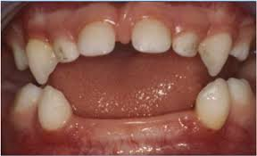
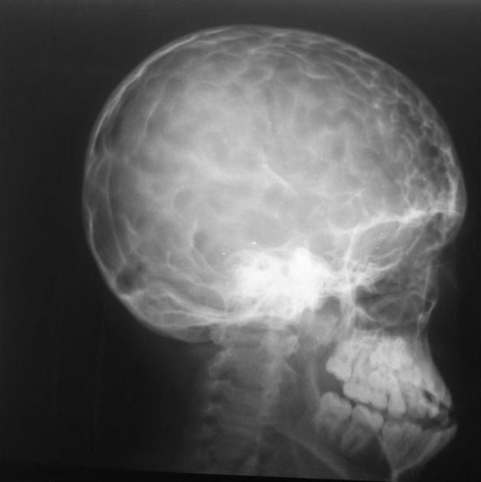

Slide 60
radiographic features of jaws
A gen radiolucency of mandible and maxilla
Cortical bone and lamina dura are thin
Poorly calcified alveolar bone and may appear deficient

Slide 61
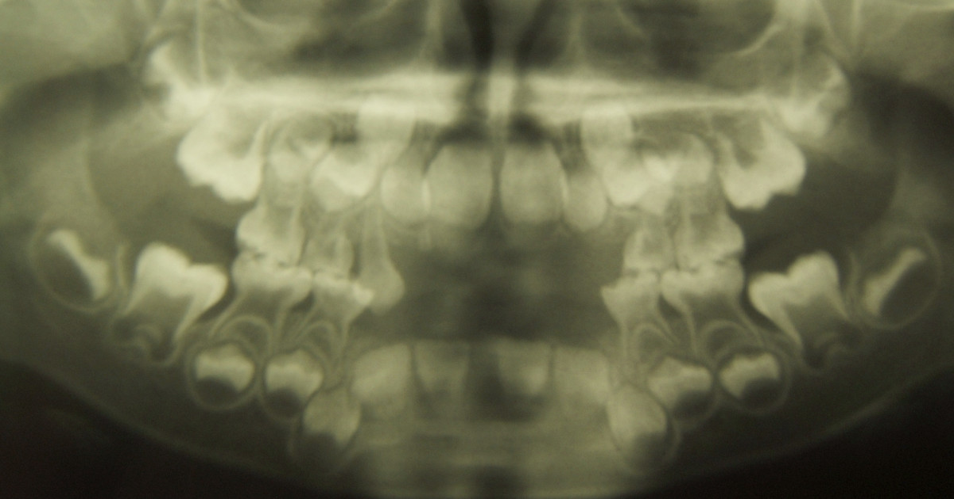
radiographic features associated with the teeth
Both dentition have a thin enamel layer and large pulp chambers and root canals
Teeth may also be hypoplastic and may be lost prematurely

Slide 62
Renal osteodystrophy
Syn: renal rickets
Bone changes result from chronic renal failure
Kidney disease interferes with hydroxylation of 25(OH)D to 1,25(OH)2D
Pts have hypocalcemia as a result of impaired calcium absorption and hyperphosphatemia resulting from reduction in renal phosphorus excreation
A prolonges low serum level of calcium stimulates parathyroid gland to produce PTH, resulting in SECONDARY HYPERPARATHYROIDISM

Slide 63
Clinical features
In children, growth retardation and frequent bone fractures may occur
Adults experience a gradual softening and bowing of bones

Slide 64
General radiographic features
Some changes resemble those in rickets and others with hyperparathyroidism
Gen loss of bone density and thinning of bony cortices
Occasional increase in bone density
Brown tumors may be seen, but are les frequent

Slide 65
radiographic features of the jaws
Density of maxilla and mandible may be less than normal and occasionally may greater than normal
Decrease or increase in no of internal trabeculae
Trabecular bone pattern may be granular
Cortical boundaries may be thinner or less apparent
The changes may persist after renal transplant coz of hyperplasia of parathyroid glands, resulting in a continued elevation of PTH

Slide 66
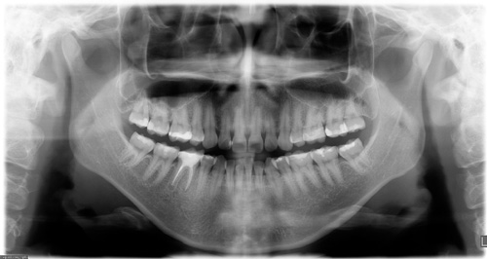
Radiographic changes associated with the teeth
Hypoplasia and hypocalcification of teeth are possible
Sometimes loss of evidence of enamel
Lamina dura may be absent or less apparent

Slide 67
Hypophosphatemia
Syn: vit D resistant rickets, hypophosphatemic rickets
A group of inherited conditions that produce renal tubular disorders resulting in excessive loss of phosphorus
There is a failure to resorb phosphorus in distal renal tubules, resulting in decrease in serum phosphorus

Slide 68
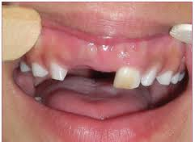
Clinical features
Reduced growth and rickets like bony changes
Bowing of the legs, enlarged epiphyses and skull changes
Adults have bone pain, muscle weakness and vertebral fractures

Slide 69
General radiographic features
Are indistinguishable from rickets
In adults, long ones may show persistent deformity, fractures or pseudofractures
r/g of jaws: usually osteoportic and In extreme cases r’lucent
Cortical boundaries may be unusually r’lucent or not apparent
Fewer visible trabeculae and a granular trabecular pattern

Slide 70
Radiographic features associated with the teeth
Teeth may be poorly formed with thin enamel caps and large pulp chambers and root canals
Periapical and periodontal abscesses occur frequently
Periapical rarefying osteitis without an etiology may bbe a result of large pulp chambers and defects in dentin formation, allowing ingress of oral microorganisms and subsequent pupal necrosis
If disease is sever, pt experiences premature loss of teeth
Lamina dura may become sparse and cortical boundaries around tooth crypts may be thin or entirely absent

Slide 71
Ostepetrosis
Syn: Albers-Schonberg and marble bone disease
Results from defect in differentiation and function of osteoclasts
Lack of normally functioning osteoclasts results in abnormal formation of primary skeleton and a gen increase in bone mass
Failure of normal bone remodelling results in dense, fragile bones that are susceptible to infection and fracture
Obliteration of marrow compromises hematopoiesis and compress cranial nerves

Slide 72
Clinical features
More, severe, recessive form is seen in infants and young children and the more benign, dominant from appears later
Severe form is fatal early in life
Pt experiences progressive loss of bone marrow and its cellular products and a severe increase in bone density
Narrowing of bony canals results in hydrocephalus, blindness, deafness, vestibular nerve dysfunction and facial nerve paralysis

Slide 73
Clinical features
Benign, dominant form is milder and may be entirely asymptomatic
Incidental finding or appears as pathologic fracture
In more chronic cases, bone pain and cranial nerve palsies caused by neural compression may be a problem
Osteomyelitis may complicate the disease coz of relative lack of vascularity of dense bone

Slide 74
General Radiographic features
All bones show greatly increased density, which is bilaterally symmetric
Increased density throughout the skeleton is homogenous and diffuse
Trabecular pattern of medullary cavity may not be visible
Radiopacity reduces the contrast b/w outer cortical border and cancellous portion of bone
Entire bone may be mildly enlarged

Slide 75
r/g of the jaws
Fails to reveal any internal structure and even roots of the tooth may not be apparent
Increased bone density and relatively poor vascularity results in susceptibility of mandible to osteomyelitis, usually from odontogenic inflammatory lesions

Slide 76
r/g features associated with teeth
Delayed eruption, early tooth loss, missing teeth, malformed roots and crowns and teeth that are poorly calcified and prone to caries
Eruption pattern of both dentition may be delayed s a result of bone density or ankylosis
Lamina dura and cortical borders appear thicker than normal

Slide 77
treatment
Bone marrow transplants in an attempt to stimulate formation of functional osteoclasts and systemic steroids for hematologic component
Osteomyelitis: antibiotics and hyperbaric oxygen therapy
Avoidance of odontogenic inflammatory disease

Slide 78
Other systemic disease
Progressive systemic sclerosis
Sickle cell anemia
Thalassemia

Slide 79
Progressive systemic sclerosis
Syn: scleroderma
Is a gen connective tissue disease that causes hardening of skin and other tissues
Involvement of GIT, heart, lungs and kidneys usually result in more serious complications
Cause of disease is unknown

Slide 80
Clinical features
Middle age, 30-50 yrs
Women are affected about 3 times as often as men
Involved skin has a thickened, leathery quality
Skin is not mobile over underlying soft tissues
Involvement of facial region may inhibit mandibular opening
Pts with diffuse disease are likely to have xerostomia, decayed, missing or filled teeth and carious lesions
Pts with systemic disease are likely to have deeper periodontal pockets and higher gingivitis score
Pts with cardiac and pulmonary problems have varying degrees of heart failure and respiratory insufficiencies
Renal involvement leads to some degree of uremia, with or without hypertension

Slide 81
Radiographic features of the jaws
An unusual pattern of mandibular erosions at regions of muscle attachments such as angles, coronoid process, digastric region or condyles
Resorption is typically bilateral and fairly symmetric
Erosive borders are smooth and sharply defined
The resorption may be progressive with the disease

Slide 82
Radiographic changes associated with the teeth
Increase in width of periodontal ligament spaces around the teeth
PDL spaces affected usually are atleast twice as thick as normal and all anterior and posterior teeth are affected
More pronounced around posterior teeth
Lamina dura remains normal
Gingival attachments are normal and not mobile
Half of the pts with PDL space thickening also had some mandibular erosive bone changes

Slide 83
d/d and management
Tooth mobility
Orthodontic movement
Intermaxillary fixation with arch bars
Invasion of PDL by malignant neoplasms
Management: progressive loss of bone in angle is more serious coz of potential fracture

Slide 84
Sickle cell anemia
Is an autosomal recessive, chronic hemolytic blood disorder
Pt with this disorder have abnormal hb, which under low oxygen tension results in sickling of red blood cells
These blood cells have a reduced capacity to carry oxygen to tissues and coz of damage to membrane lipids and proteins adhere to vascular endothelium and obstruct capillaries
Spleen traps and readily destroys these abnormal red cells
Hematopoeitic system responds to resultant anemia by production of RBCs, which requires compensatory hyperplasia of bone marrow

Slide 85
Clinical features
Most pts with the disease manifest mild, chronic features
Long, quiet spells of hemolytic latency occur, occasionally punctuated by exacerbations – sickle cell crisis
During crises, pts experience severe abdominal, muscle and joint pain, have a high temperature and may even undergo circulatory collapse
In mild phase, pt may also c/o fatigue, weakness, shortness of breath and muscle and joint pain
Many pts die of complications before the age of 40 yrs

Slide 86
General r/g features
Hyperplasia of bone marrow at expense of cancellous bone is primary reason
Thinning of individual cancellous trabeculae and cortices is common in vertebral bodies, long bones, skull and jaws
Skull may have widening of diploic space and thinning of outer and inner tables
In extreme cases, outer table of skull will not be apparent and hair on end appearance may occur
Small areas of infarcation may be present within bones after blockage from microvasculature, seen as areas of localized bone sclerosis
Retardation of gen bone growth

Slide 87
r/f of the jaws
Gen osteoporosis, coz of decrease in volume of trabecular bone and to a lesser extent thinning of cortical plates
Most cases, change is mild to moderate
Bone pattern may be altered to one with fewer but coarser trabeculae
Bone marrow hyperplasia may cause enlargement and protrusion of maxillary alveolar ridge

Slide 88
Thalassemia
Syn: cooley’s anemia, mediterranean anemia and erytroblastic anemia
It is a hereditary disorder that results in defect in Hb synthesis
Defect may involve either alpha or beta globulin genes
Resultant RBCs have reduced Hb content, are thin and have short life span
Heterozygous form is mild, thalassemia minor, is mild whereas homozygous form, thalessemia major may be severe
A moderately sever form, thalessemia intermedia also occurs

Slide 89
Clinical features
In severe form, onset is in infancy and survival time may be short
Face develops prominent cheek bones and a protrusive premaxilla resulting in rodent like face
Milder form of disease occurs in adults

Slide 90
General Radiographic features
r/g features result from hyperplasia of ineffective bone marrow and its subsequent failure to produce normal red cells
There is a gen r’lucency of long bones with cortical thinning
Diploic space exhibits marked thickening, splly in frontal region
Skull shows gen granular appearance and occasionally hair in end effect may develop

Slide 91
Radiographic appearance of jaws
Sever bone marrow hyperplasia prevents pneumatization of PNS, splly maxillary sinus and cause an expansion of maxilla that results in malocclusion
Jaws appear r’lucent, with thinning of cortical borders and enlargement of marrow spaces
Trabeculae are large and coarse
Lamina dura is thin and the roots may be short

