Slide 1
MAXILLARY SINUS

Slide 2
Anatomy
The maxillary sinus was first described in 1651, by Nathaniel Highmore. Therefore, it is also known as antrum of Highmore
Maxillary sinuses are two in number, one on either side of the maxilla, and they are the largest of the paranasal air sinuses
Dimensions –
3.5 × 3.2 × 2.5 cm (Turner 1902)
Volume- 15 to 30 ml
The ostium (3 to 6 mm diameter) opens into middle meatus

Slide 3
It can be described as pyramidal in shape
Maxillary Sinus consist of
The base -lateral wall of the nose.
The apex -zygomatic process of maxilla;
The four walls are formed by:
the roof of antrum or the floor of orbit,
the anterior, and
infratemporal surfaces of body of maxilla, and
floor of sinus- the alveolar process of maxilla which is the

Slide 4
Teeth in proximity
2^{nd,} 1st , molar>3rd molar>2nd pm>1st pm>canine

Slide 5
Embryology (Growth of Maxillary Sinus)
In early stages, maxillary sinus is high in maxilla. Later gradually grows downward, by a process of pneumatization
Birth Tubular: 2 cm × 1 cm × 1 cm 3 mm per year -Tubular
9 years 60% of adult size-Ovoid
18 years Adult size-Pyramidal

Slide 6
Physiology
Pseudostratified columnar ciliated epithelium
Also Known as ‘Schneiderian membrane’
Mucociliary mechanism is useful means for removal of particulate matter, bacteria etc.
The cilia move the mucus and other debris towards the ostium and subsequently discharged in the middle meatus.

Slide 7
Functions of sinus
Impart resonance to the voice.
Increase the surface area and lighten the skull.
Moisten and warm the inspired air.
Filter the debris from the inspired air.
Sinuses are located in front of the forebrain, olfactory region, etc. They create “air padding” to provide thermal insulation to the important tissues mentioned above.

Slide 8
Vascularization & innervation
 | a) Nasal Mucosal Vasculature
Arterial Supply | SP, Ethmoid b) Osseous Vasculature
Venous Drainage | IO, PSA, ASA, GP, Facial Medial wall - SP Other walls – Pterygomaxillary Plexus
Lymphatic Drainage | Collecting vessels in middle meatus
Nerve Innervation | ION, GP, PSA, MSA, ASA

Slide 9
Nerve Supply
superior dental nerves (anterior, middle and posterior), and the greater palatine nerve.

Slide 10
Applied Surgical Anatomy
Relation of the Root Apices with the Floor of the Sinus
In adults, there is a distance of approximately, 1-1.25 cm between the floor of the sinus and the root apices of maxillary posterior teeth
Low Incidence of Oroantral Fistula in Children under Fifteen Years
The maxillary sinus reaches its normal adult size by the age of 15 years
Lining of Maxillary Sinus
The wall of the sinus is very thin in this area. This area is used for following: (i) diagnostic aspiration, and (ii) the site for Caldwell-Luc operation; that is, the antral exploration with or without an intraoral antrostotomy

Slide 11
Fractures of the Middle Third of Face
LeForte I, II, and III, show disturbance in the walls of maxillary sinus.
Paraesthesia in Maxillary Teeth Following Surgical Procedures

Slide 12
Radiology of Maxillary Sinus
The various radiographs useful are as follows:
1. Extraoral views: (i) Occipitomental (OM), (ii) Lateral skull, (iii) Submentovertex (SMV), (iv) Linear tomography, (v) Orthopantomography, and (vi) Computed axial tomography (CAT).
2. Intraoral: (i) Occlusal, (ii) Lateral occlusal, and (iii) Periapical.

Slide 14
Maxillary sinusitis
Group of diseases mainly inflammation & infection which affect the nasal mucosa and PNS

Slide 15
Acute Maxillary Sinusitis
Duration- 7 days-4 week
May be suppurative or non suppurative
Symptoms
Cold 3-4 days prior to acute attack
Postnasal discharge with pharyngitis
Constant throbbing pain
Generalized constitutional symptoms
Signs
Tenderness & mild swelling over cheek
Paresthesia over cheek
Fetor oris, discharge of pus in to mouth through OAF

Slide 16
Chronic Maxillary Sinusitis
Pathophysiology-
Hyperplasia or atrophy of Mucus membrane
Cilia are lost, multiple polyp formation
Ostium shows oedematous leads to complete blockage
Causes
It may be due to-
Persistent dental focus
Chronic rhinitis
Allergic condition
Chronic infection of frontal & ethamoidal sinuses

Slide 17
Clinical features-
Asymptomatic
Sometimes pain & tenderness in antrum area
Unilateral foul discharge from posterior nares
Fetid odour with bad taste

Slide 18
Classical antral regimen includes:
Bed rest, plenty of fluids, maintenance of oral hygiene. The regimen should be carried out for at least five to seven days.
Antimicrobials The most suitable against common antral pathogens are: (1) Macrolides: Erythromycin 250-500 mg six hourly for 5 days. (2) Broad spectrum group: Amoxicillin 250 to 500 mg eight hourly for five days.

Slide 19
Decongestants
e.g. Ephedrine sulphate— 0.5 to 1 per cent in normal saline, six hourly.
ii. Xylometazolin hydrochloride 0.1 per cent.
Mucolytic agents
Drugs used—volatile oil preparations are used, Tinc.benzoin, camphor, menthol, chlorbutol, etc. or simple steam inhalation every four hourly can be used.
Non-steroidal anti-inflammatory analgesic agents (i) Aspirin (ii) Paracetamol (iii) Ibuprofen

Slide 20
Oroantral fistula
It is an epitheliazed, pathological, unnatural communication between the oral cavity and maxillary sinus
Duration and width of lumen contributes to infection of sinus.
OAC OAF(incidence: 0.3-3.8 %)

Slide 21
Oroantral fistula
OAC OAF
Defect > 5mm diameter
No approximation of gingival tissues
Post op regime not followed
Loss of clot or wound dehiscence
Cyst enucleation
Smoking, drinking

Slide 22
Oroantral fistula
Etiology
Iatrogenic (50%)
Presence of periapical lesions
Injudicious use of instruments
During attempted extraction
Trauma(7.5%)
Chronic infections(11%)
Malignant diseases(18.5%)
Infected maxillary dentures(3.7%)
h/o sinus surgery(7.5%)

Slide 23
Symptoms of fresh oroantral communication (5E’s)
Escape of fluids
Epistaxis
Escape of air
Enhanced column of air.
Excruciating pain
Symptoms of established oroantral fistula (5P’s)
Pain.
Persistent purulent unilateral nasal discharge.
Post nasal drip.
Popping out of antral polyp.
Possible sequalae of generalized systemic condition

Slide 24
Oroantral fistula
Diagnosis
h/o previous extraction
Nose blowing test
Mouth mirror test
Cotton wisp test
Inspection
Radiological
IOPA
OPG
Occipitomental view

Slide 25
Management
3mm-5mm heals spontaneously(HANAZANE)
Ideal treatment :immediate surgery followed by Ab prophylaxis
Treatment of OAF within 24hrs of accident (Early)
- If edges of wounds are clean & not complicated by displacement of tooth or root in to antrum then closed by buccal flap and sutured under LA
- If complicated then treated by immediate surgery under GA

Slide 26
Treatment of delayed cases-
Cases seen after 24hrs after accident-
- Defer the surgical closure until gingival edges show sound healing i.e. 3weeks.
Cases seen 1 month after OAF- Surgical closure required.

Slide 27
Oroantral fistula
antibiotics : Penicillin & derivatives
nasal decongestants:
Ephedrine drops
Inhalations (steam,benzoin ,menthol)
Analgesics:
Aspirin 500mg
Paracetamol 500mg
Ibuprofen 400 mg
Antral lavage

Slide 28
Oroantral fistula
Temporary Therapeutic measures
Whitehead’s varnish pack
Composition-
Benzoin 44g
Storax 33g
Balsum of tolu 22g
Iodoform 44g
Solvent ether 100 parts

Slide 29
Oroantral fistula
Acrylic plates

Slide 30
Surgical closure
Temporalis flap
Forehead flap
Overview of the treatment modalities of Oro-Antral Communications
Closure of Oroantral Communications:A Review of the Literature, Susan H. Visscher et al, J Oral Maxillofac
Surg68:1384-1391, 2010

Slide 31
Surgical closure
Factors determining flap selection
Size of communication
Timeline of diagnosing
Presence of infection

Slide 32
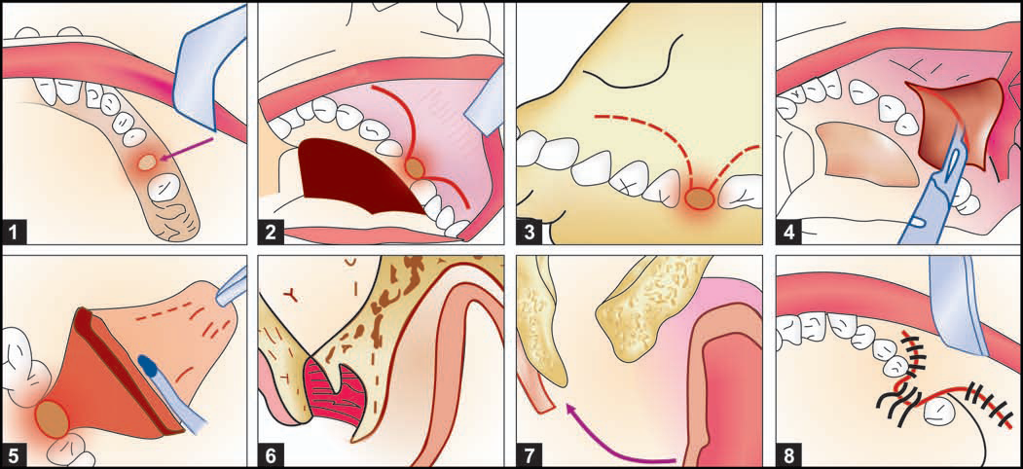
Operative technique
Buccal flap advancement Operation (Von Reherman)
oroantral fistula closure by buccal advancement flap. Modified Rehrmann’s procedure:(1) OAF, (2 and 3) Outline of buccal flap, (4 and 5) Reflection of buccal mucoperiosteal flap. Relieving incision high up through theperiosteum, (6) Sagittal section-Rehrmann buccal flap, (7) Modified Rehrmann flap with de-epithelialization of the margin of the buccal flap, which is tucked under the palatal flap over the periosteum. This ensures double layer closure. Buccal and some palatal alveolar bones are reduced with rongeurs, (8) Initial mattress suturing to pull the margin of the flap and then interrupted suturing is carried out
72

Slide 33
www.indiandentalacademy.com

Slide 34
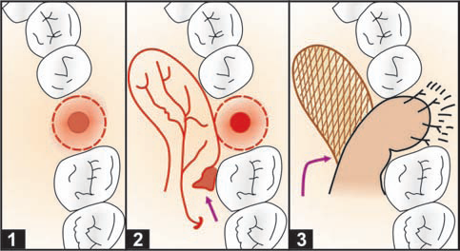
PALATAL FLAPS Rotational advancement.(Ashley 1939)

Slide 35
SUBMUCOUS CONNECTIVE TISSUE
FLAP( Ito et al 1980)

Slide 36
BUCCAL FAT PAD(Hanazawa et al
1995)

Slide 37
Combined flap

Slide 38
Tongue flap
Introduced by lexer,1909 Technique
Advantages
Disadvantages

Slide 39
Grafts

Slide 40
Caldwell luc Operation
By George Caldwell in 1893 from New York described a method of gaining entry into the maxillary sinus via canine fossa with nasal antrostomy
Indications
Open procedure for removal of root fragments, teeth or foreign body or an antrolith (stone) from the maxillary sinus.
2. To treat chronic maxillary sinusitis with hyperplastic lining and polypoid degeneration of the mucosa.
3. Removal of cysts or benign growths from the maxillary sinus.
4. Management of haematoma in the maxillary sinus and to control post-traumatic haemorrhage in the sinus.
5. Zygomaticomaxillary complex fractures involving floor of the orbit and anterior wall of the maxillary sinus.
6. Removal of impacted canine or impacted third molar.
7. Along with closure of chronic oroantral fistula, associated with chronic maxillary sinusitis.

Slide 41
Caldwell luc sinusotomy
Antibiotics, analgesics, antiinflammatory drugs for 5 days

